Slide 1
Anything but simple.
Gina Nichols
PhD Defense
Crop Physiology
August 25 2021

Slide 2
What I did
Why I did it
https://www.presentyourscience.com/

Slide 3
2018-present
Nichols et al. (in prep) Roots as drivers of the rotation effect in maize?
Nichols et al. (in prep) Using models to unravel causal mechanisms of the continuous maize penalty
Nichols & MacKenzie (in prep) Decision analysis to target cover crop research priorities in Central Iowa
Nichols et al. (in review) Winter cover cropping effects on soil water storage vary by site: Field measurements and a proposed causal model
Nichols et al. (2020). Effect of long-term cover-cropping on weed seedbanks. Frontiers in Agronomy
Nichols et al. (2020) Cover crops and weed suppression in the U.S. Midwest: A meta‐analysis and modeling study. Agricultural and Environmental Letters
Weisberger*, Nichols*, Liebman (2019) Does diversifying crop rotations suppress weeds? A meta-analysis. PloS one
Nichols et al. (2019) Maize root distributions strongly associated with water tables in Iowa, USA Plant and Soil
Bird, Nichols, et al. (in review). Means, motive, and opportunity: A stakeholder analysis method to understand likelihood of action in food-energy-water systems. Elementa
Pasley, Nichols, et al. (2021). Rotating maize reduces the risk and rate of nitrate leaching. Environmental Research Letters.
Archontoulis, Castellano, Licht, Nichols, et al. (2020) Predicting crop yields and soil-plant nitrogen dynamics in the US Corn Belt. Crop Science
Liebman & Nichols (2020) Cropping system redesign for improved weed management: A modeling approach illustrated with giant ragweed (Ambrosia trifida). Agronomy
Martinez-Feria, Nichols, et al. (2019) Can multi-strategy management stabilize nitrate leaching under increasing rainfall? Environmental Research Letters

Slide 4
Longer rotations may benefit corn roots
Rotating corn reduces the risk of nitrate leaching
Cropping systems with more variation in planting dates have less weeds
Cover crops can effectively complement herbicides
(Cover crop termination – corn planting) window is where producers are exposed to the most risk

Slide 5
Longer rotations may benefit corn roots
Rotating corn reduces the risk of nitrate leaching
Cropping systems with more variation in planting dates have less weeds
Cover crops can effectively complement herbicides
(Cover crop termination – corn planting) window is where producers are exposed to the most risk

Slide 7
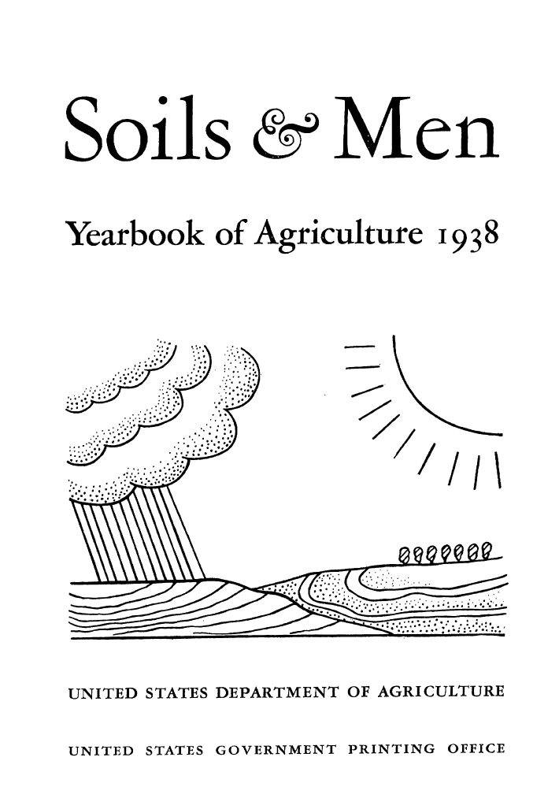
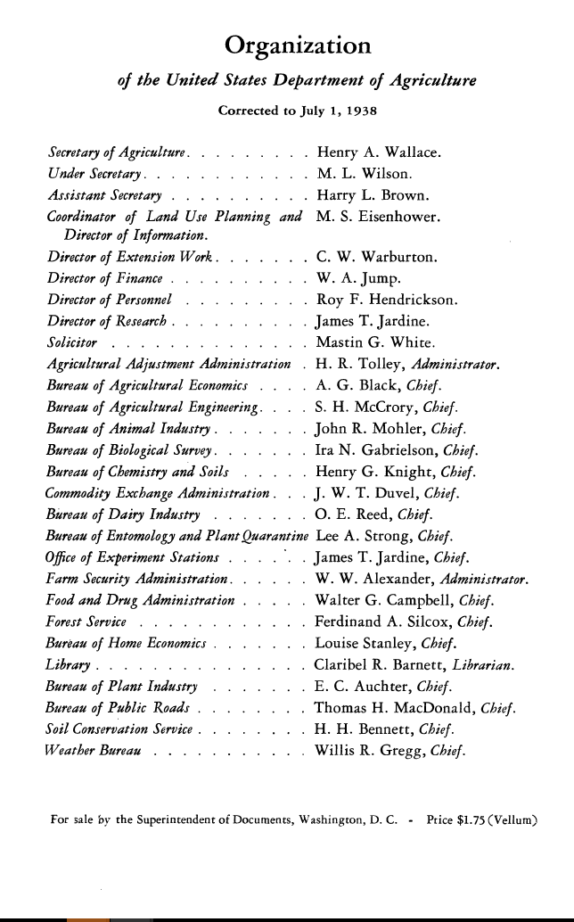

Slide 8
People

Slide 10
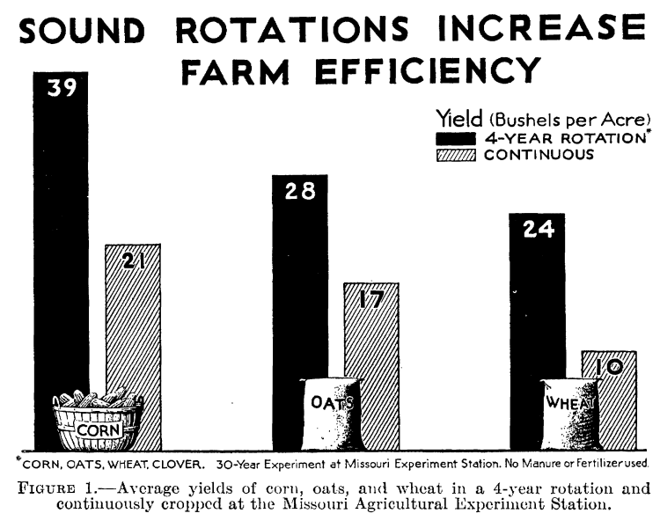

Slide 11
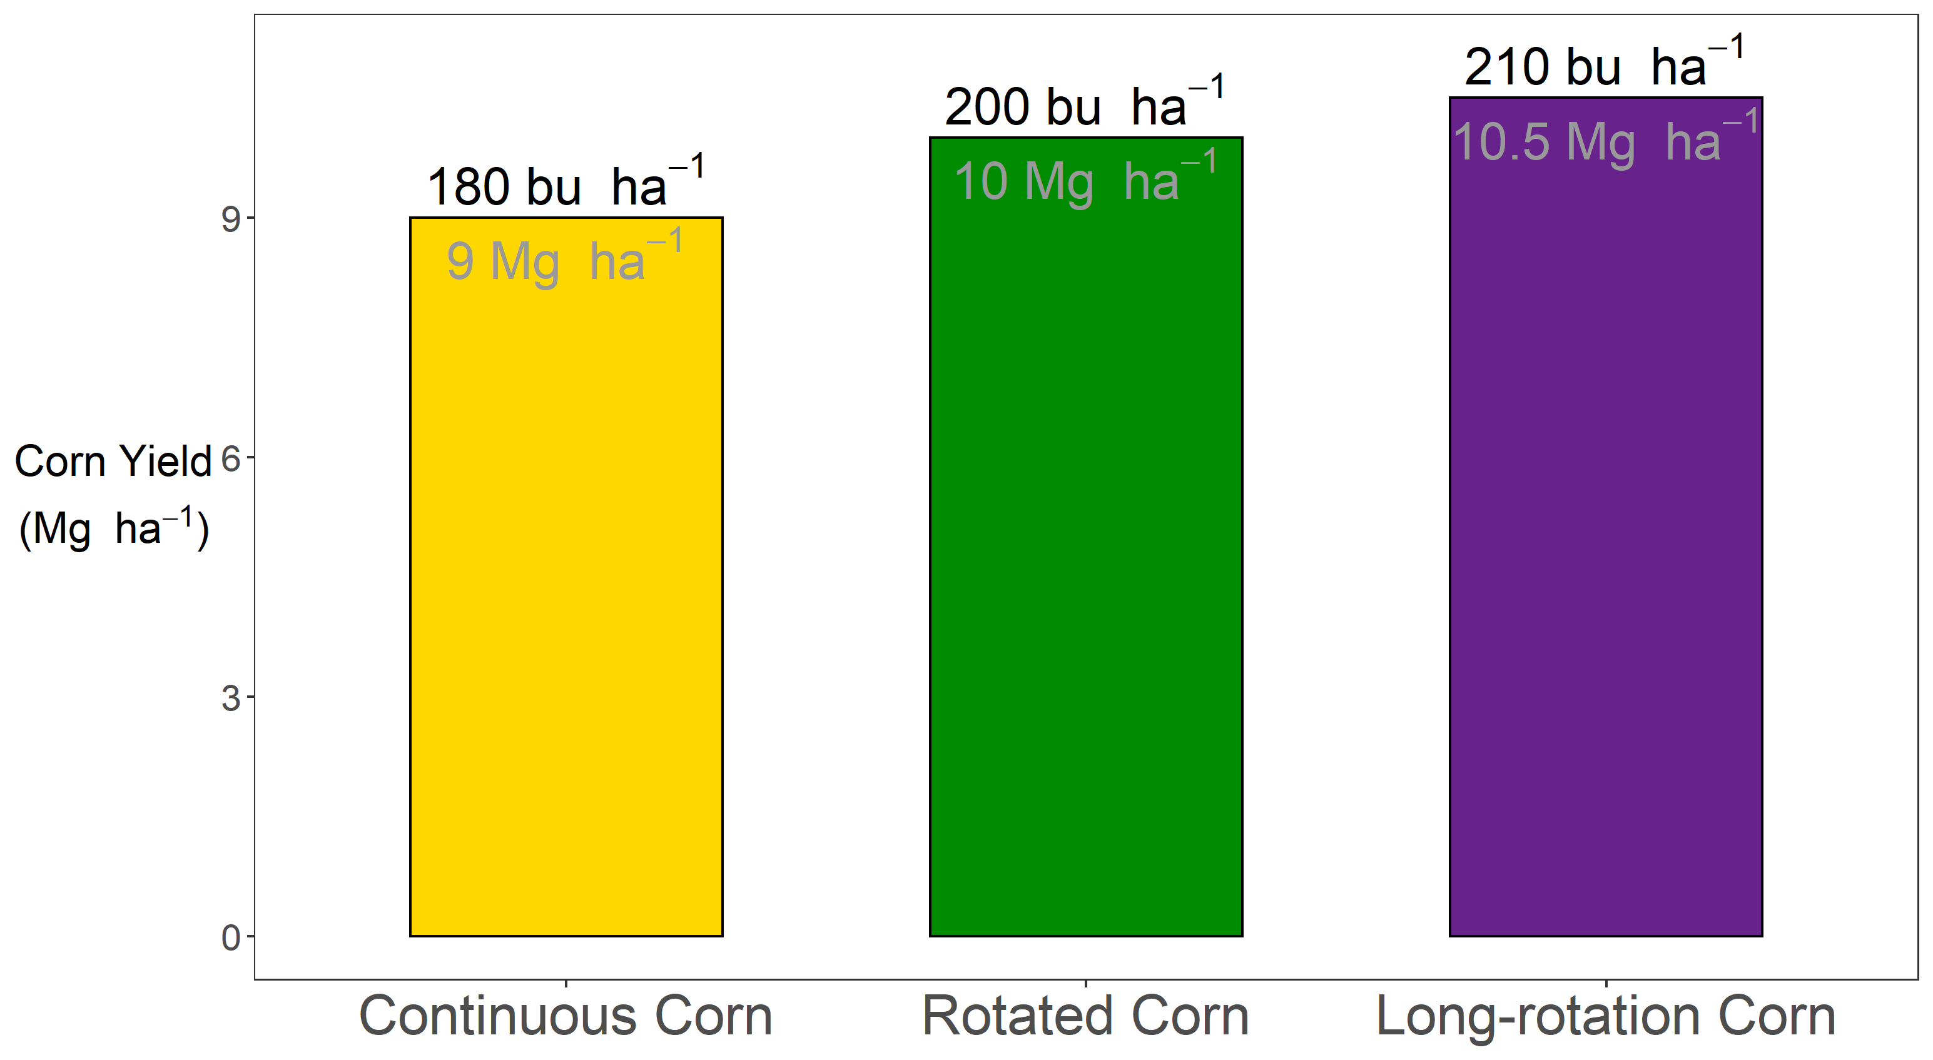


Slide 12


Slide 13
?

Slide 14


Slide 15
Agronomist (noun):
A person who is continuously fascinated by how corn responds to nitrogen

Slide 16
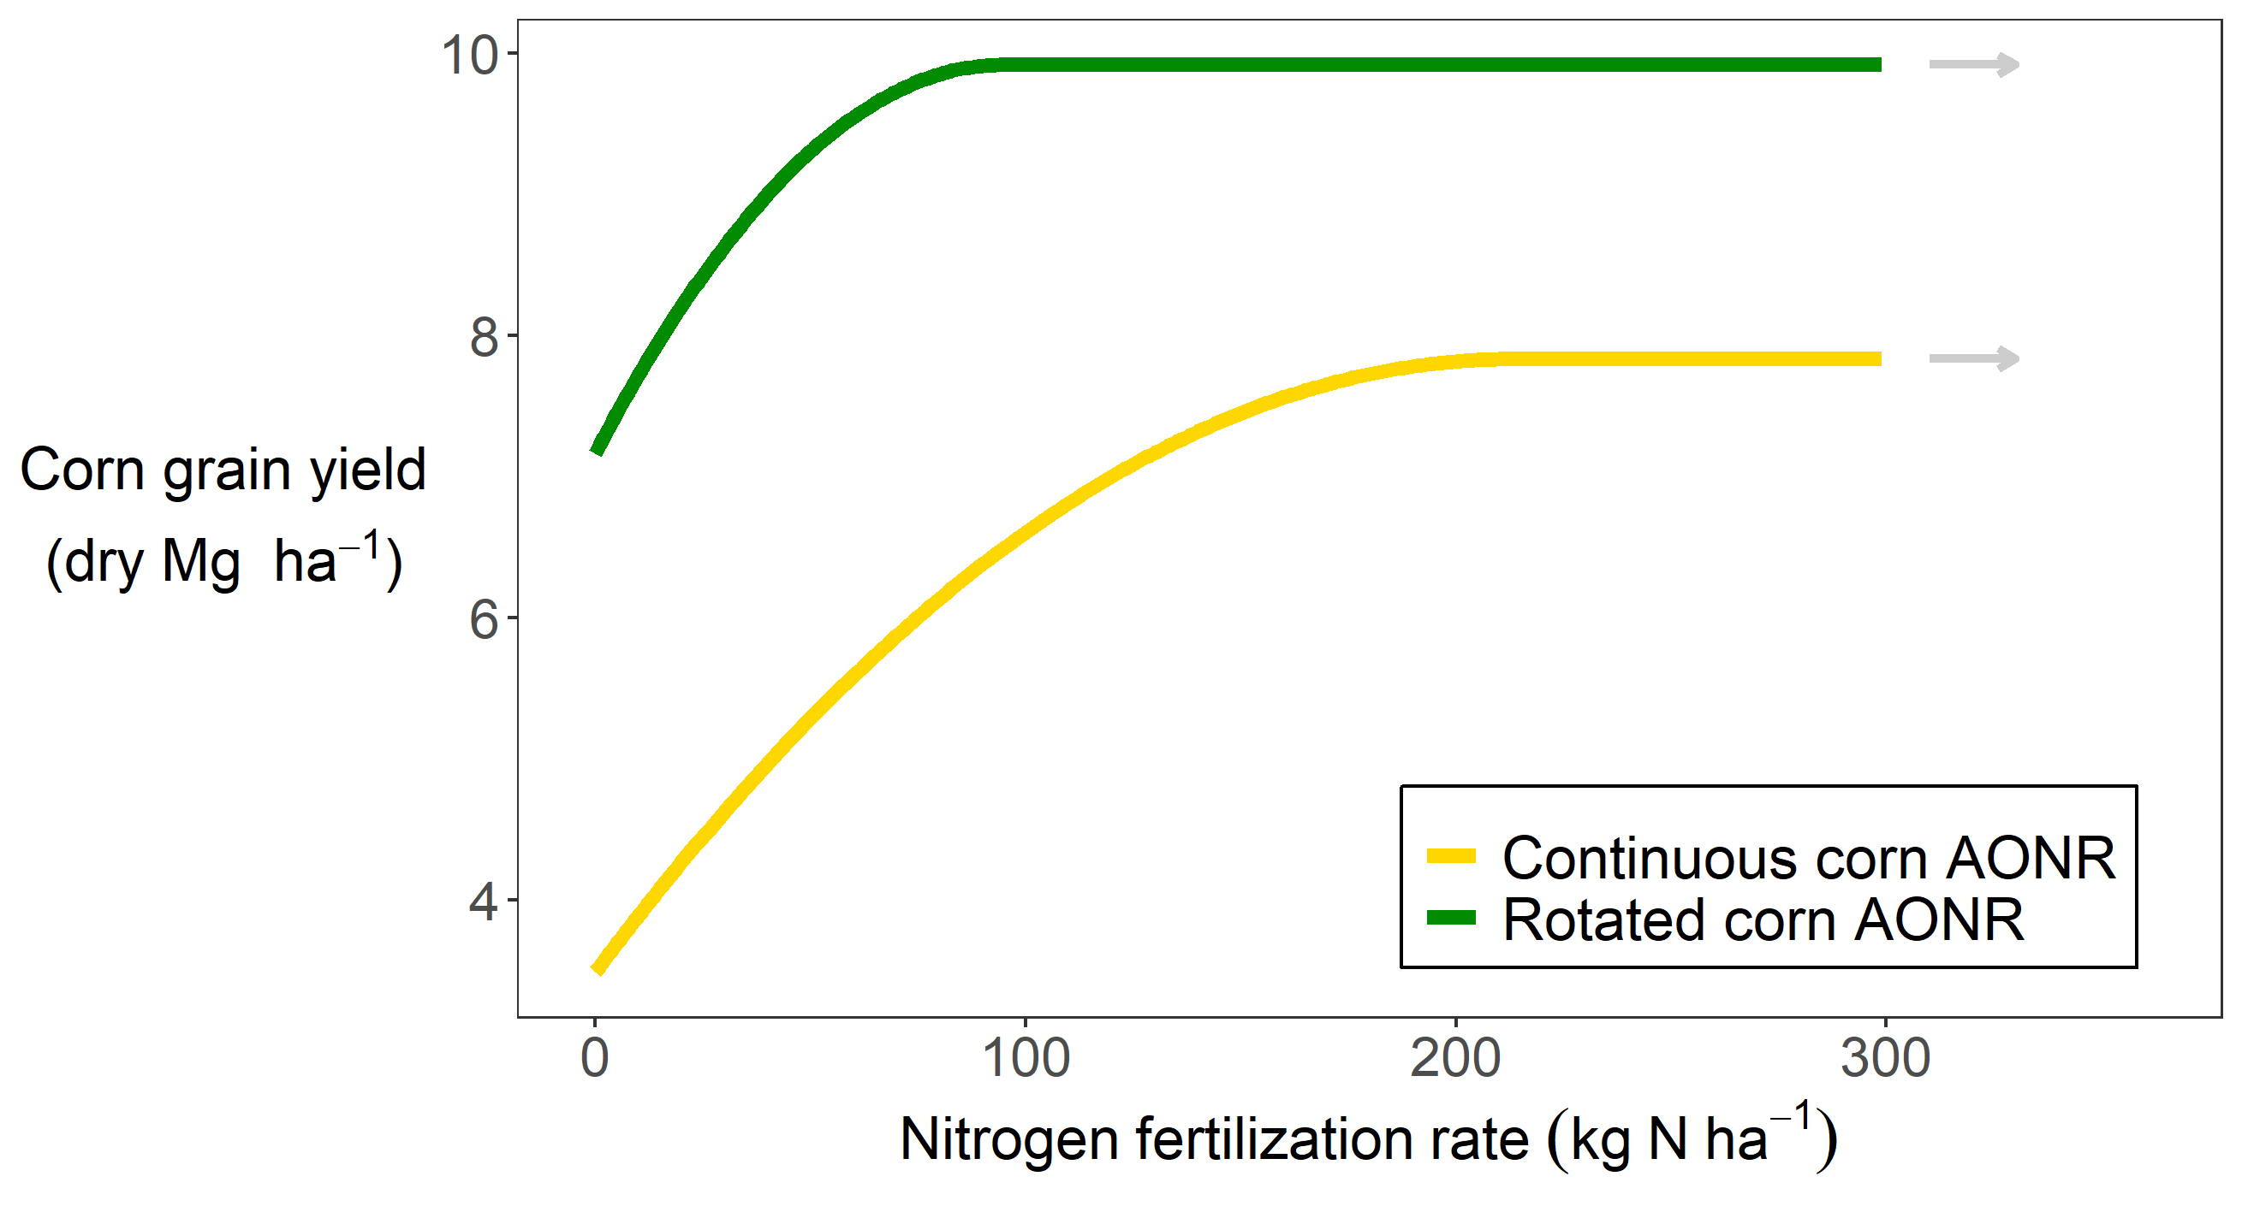

Slide 17
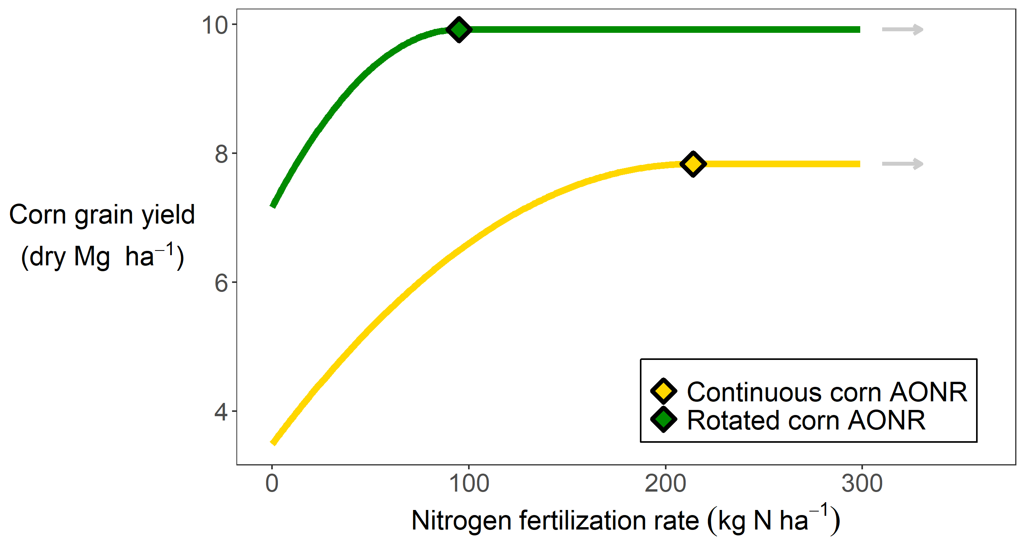
Notes:
Mention EONR

Slide 19
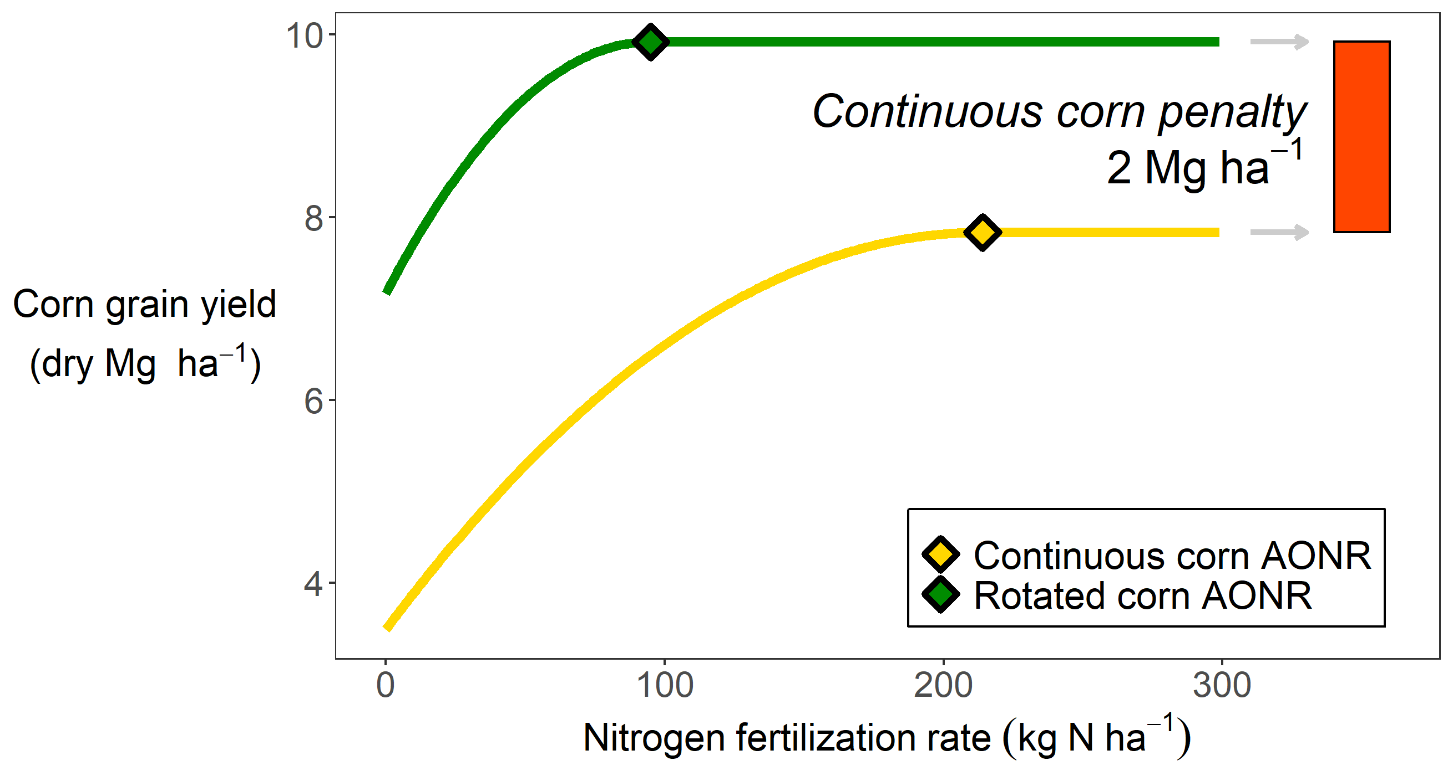
Notes:
This is an information-rich figure, which is one reason this is truly fascinating. Firstly, you can see rotated corn needs less nitrogen to reach it’s yield plateau compared to continuous corn. In this instance rotated corn required about 100 kg N, and continuous corn about 225. Secondly, you’re applying more than twice the fertilizer, and are releasing all that extra nitrous oxide associated with fertilizer application, but are still achieving a lower yield. Some of my other work has also shown that if you overshoot the AONR (and most farmers aim to overshoot, which is another story), but if you overshoot the AONR in the rotated corn, your nitrate leaching doesn’t immediately skyrocket. In fact you can overshoot it by about 50 kg/ha, and be ok. In the continuous corn, your buffer is less than half that – about 20 kg N. So when we talk about using land efficiently, and with minimal environmental impact, continuous corn presents major challenges. So it’s important to understand why this is happening.

Slide 20
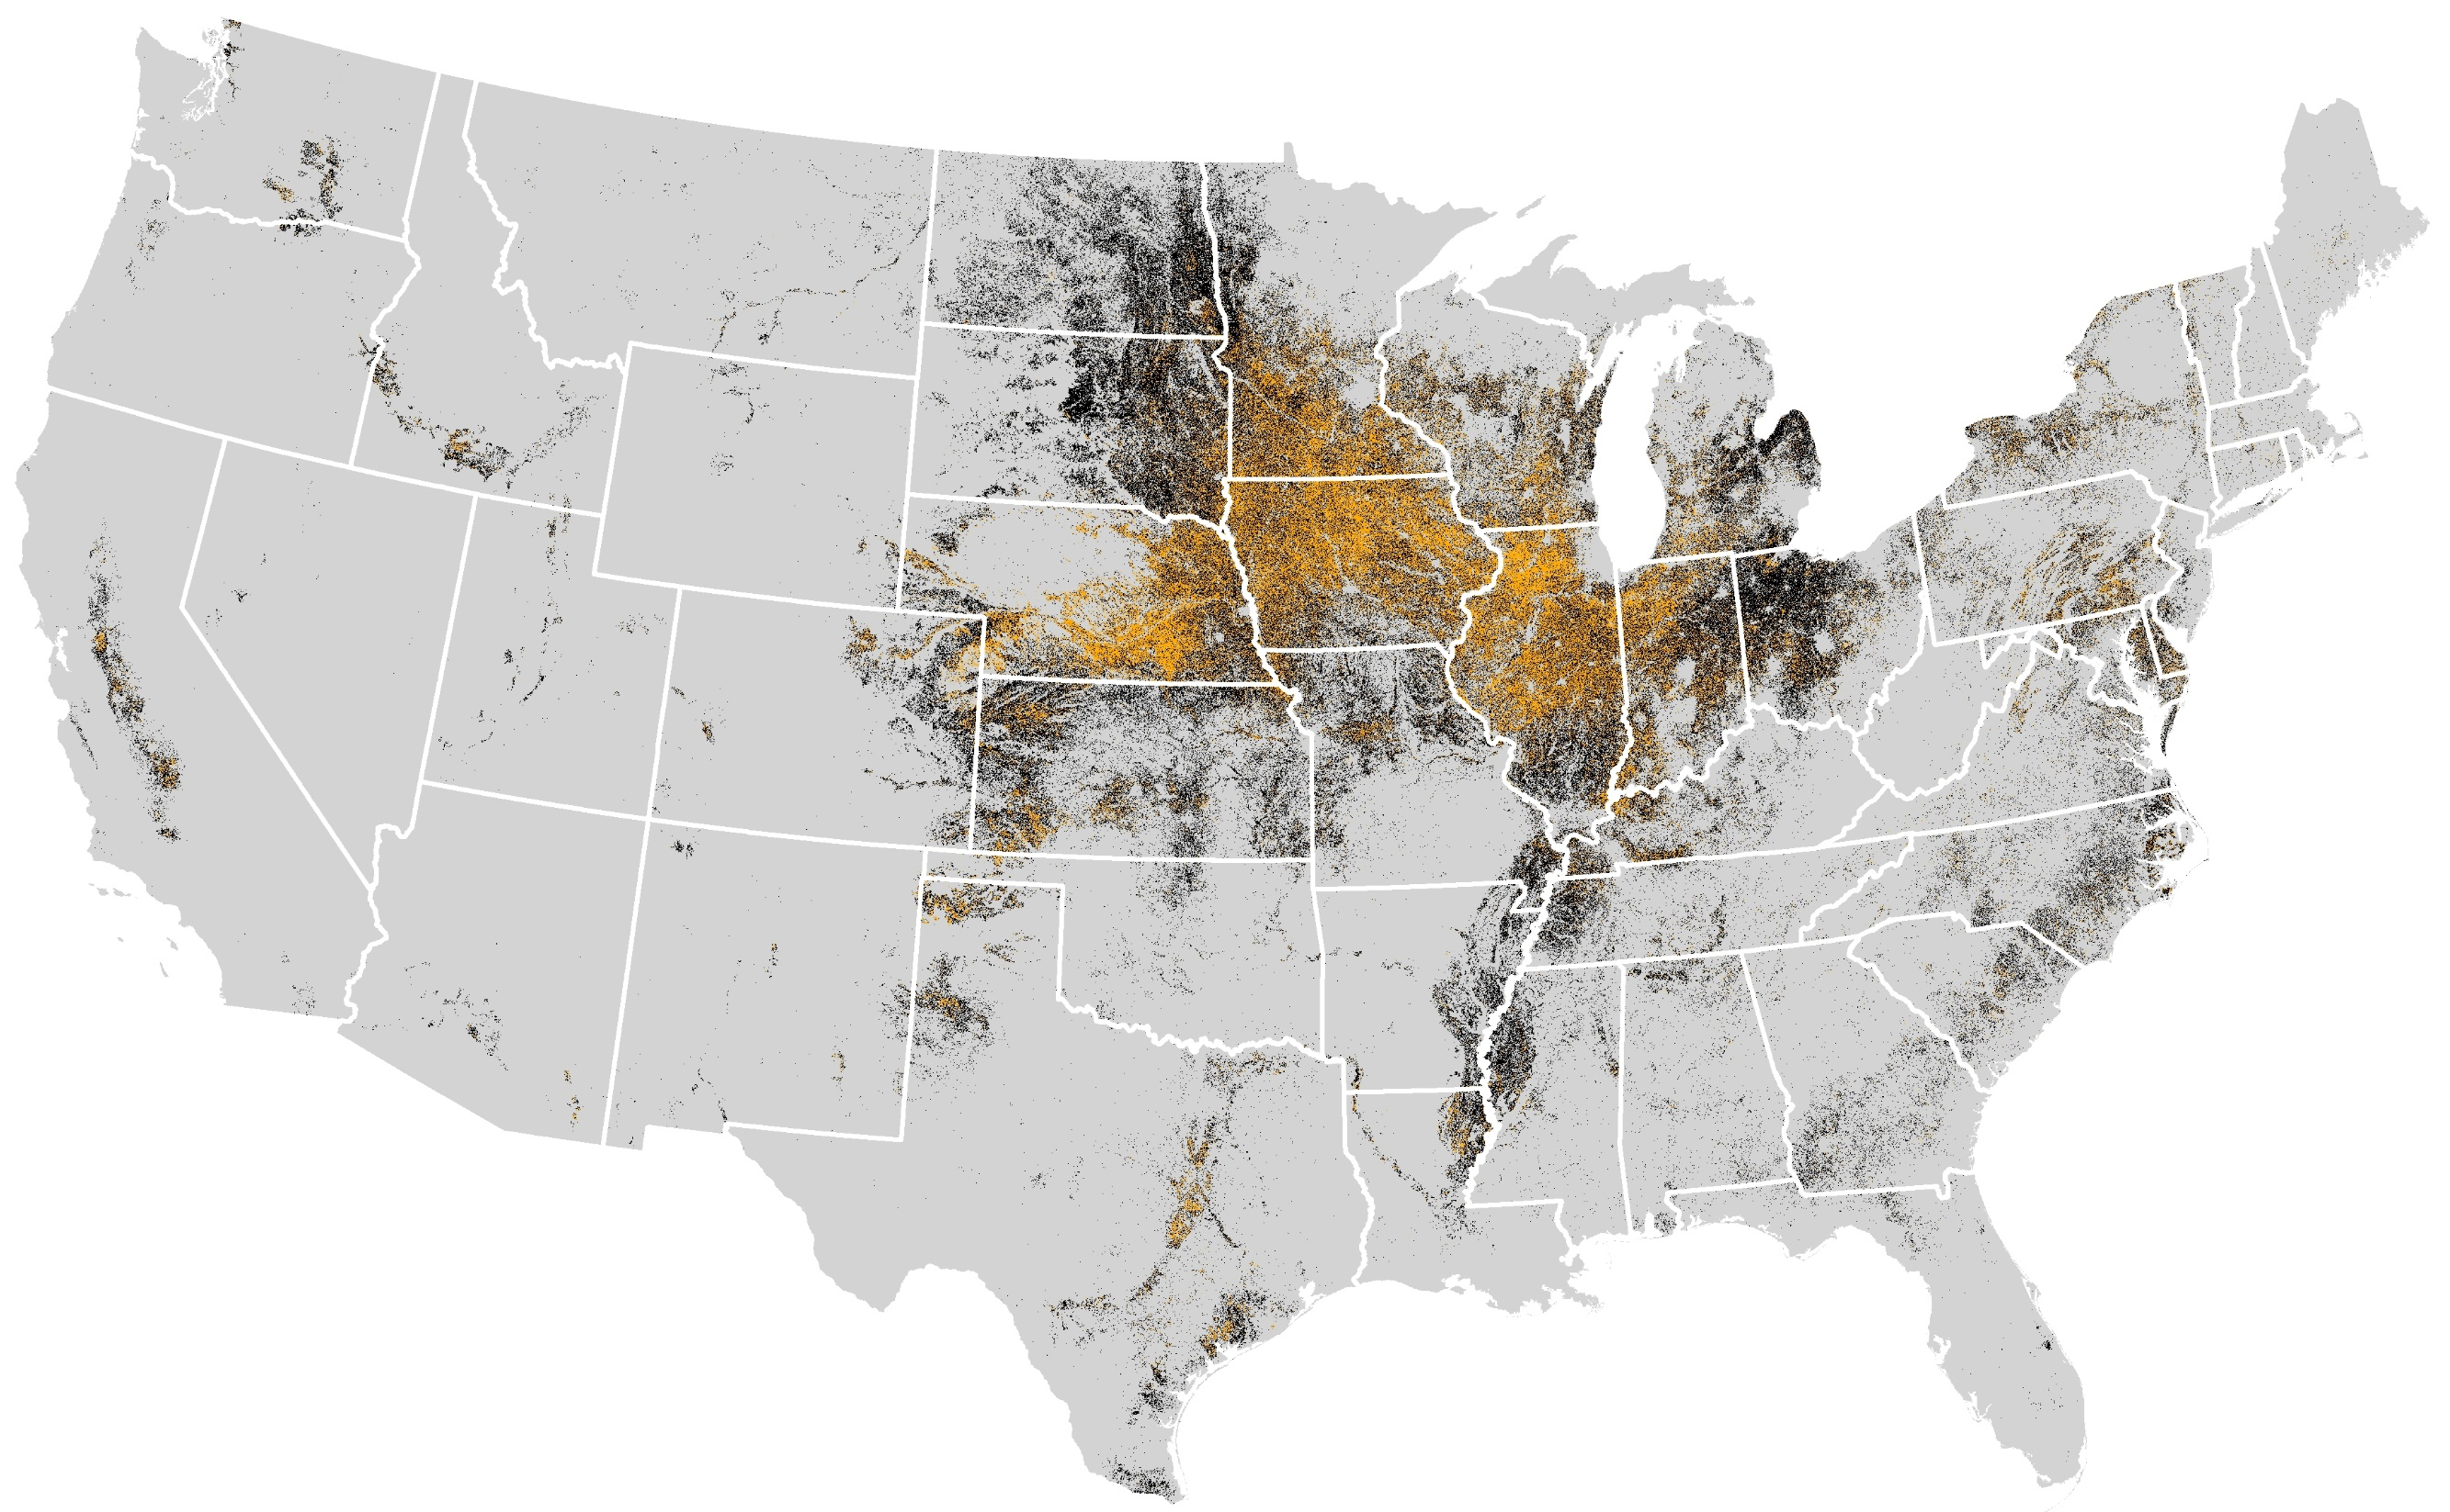
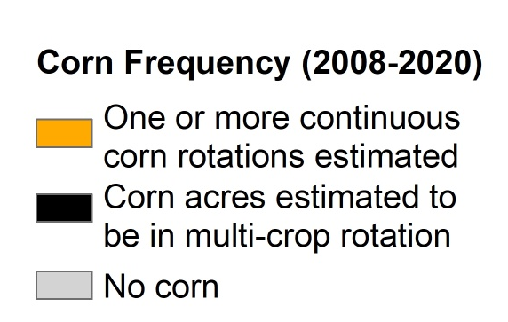
Cont corn map
Corn system (2008-2020)
Corn grown for two or more consecutive years
Corn grown in multi-crop rotation
No corn grown
Map courtesy of Jess Nelson
Data Source: https://www.nass.usda.gov/Research_and_Science/Cropland/Release/index.php
Notes:
The continuous corn penalty affects a significant amount of land. Here, each black dot represents a 30 meter by 30 meter area of land that has had corn on it in the past 12 years. The orange dots represent land that has had corn on it for 2 or more consecutive years in the past 12 years. Approximately one third of all corn grown is subject to the continuous corn penalty.

Slide 22
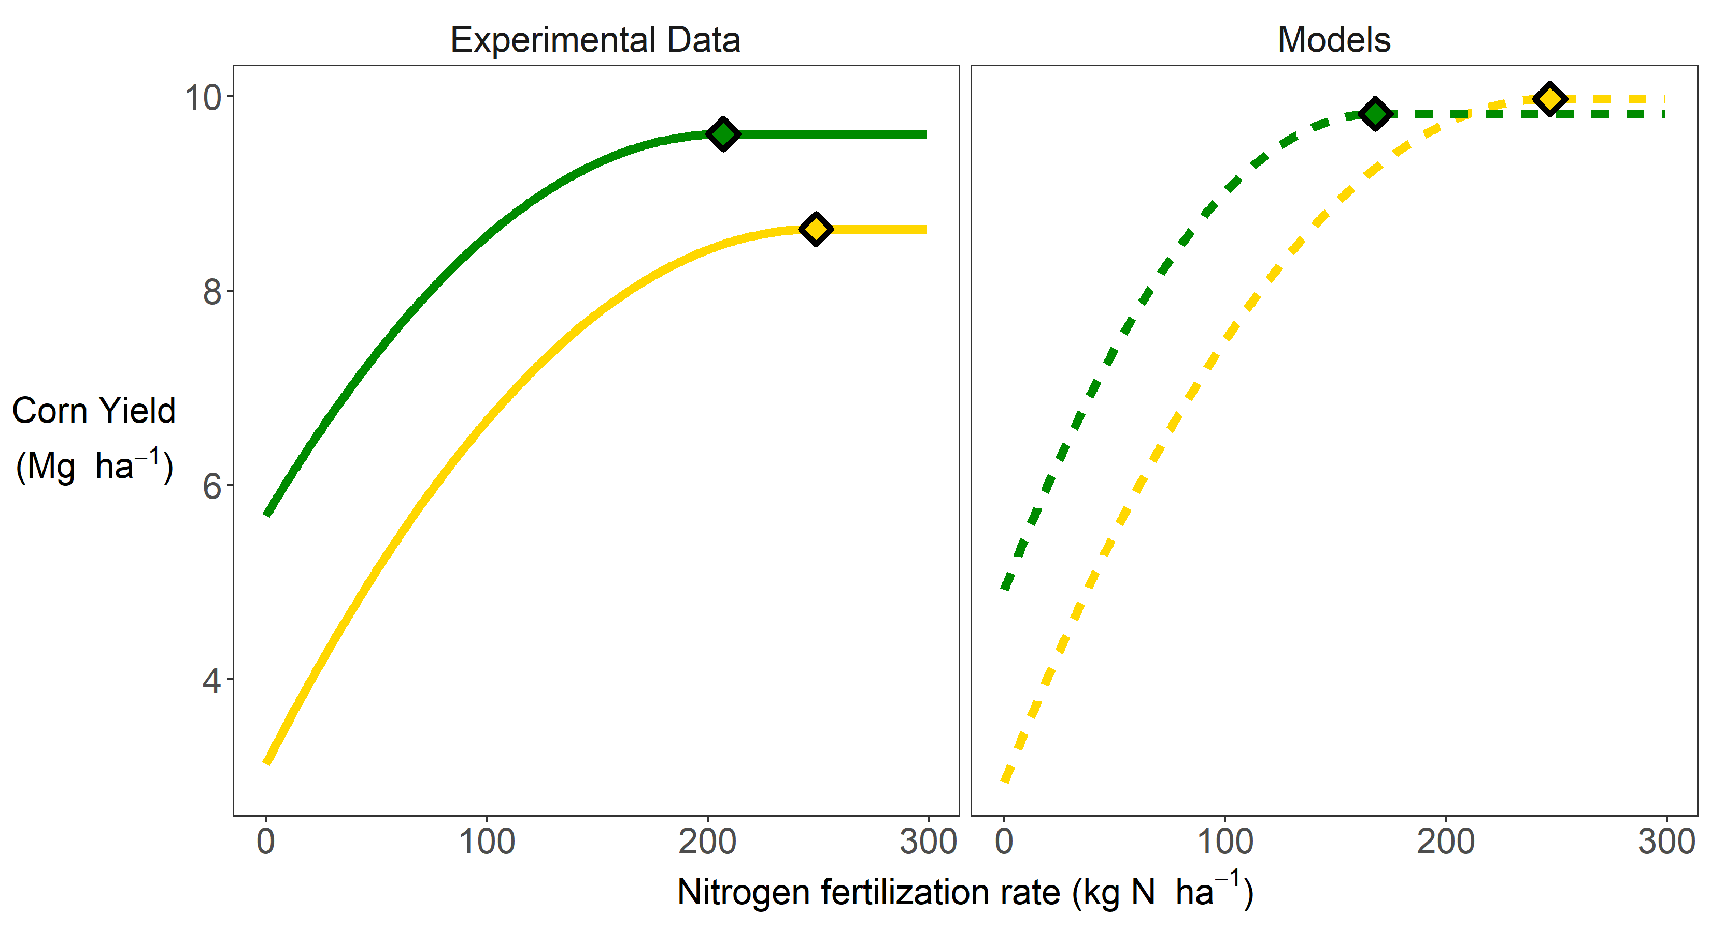
Notes:
Despite it’s importance, there are no models that take the non-water and non-nitrogen components of this penalty into account. That means models are overpredicting corn yields, which has implications for carbon, water, nutrient balances, among other things. We need to understand the causal mechanisms behind this so we can incorporate that knowledge into our models. And it’s not just corn. The majority of major agronomic crops exhibit some kind of continuous cropping penalty, and it’s really difficult to study which has meant it’s easier to ignore.

Slide 23
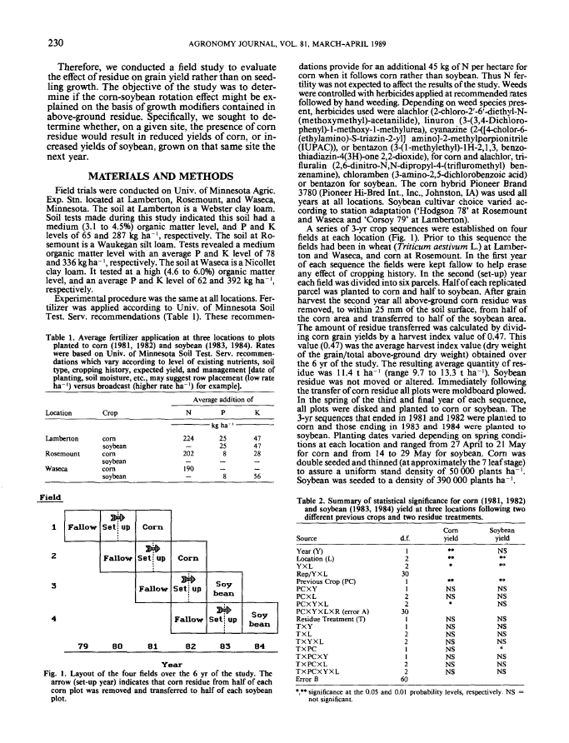
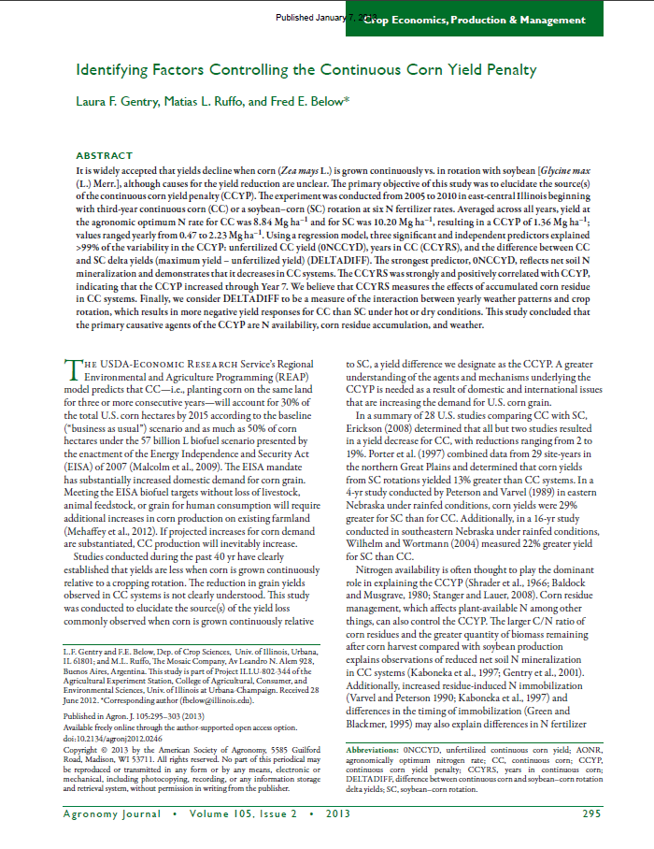
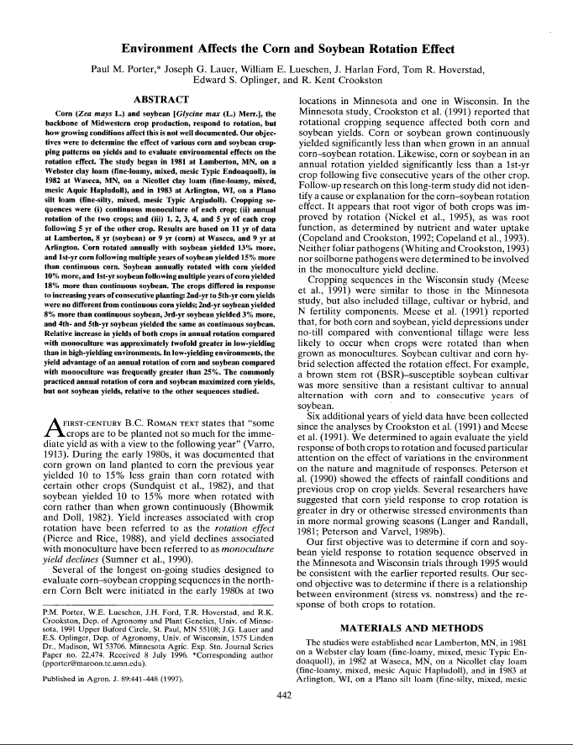

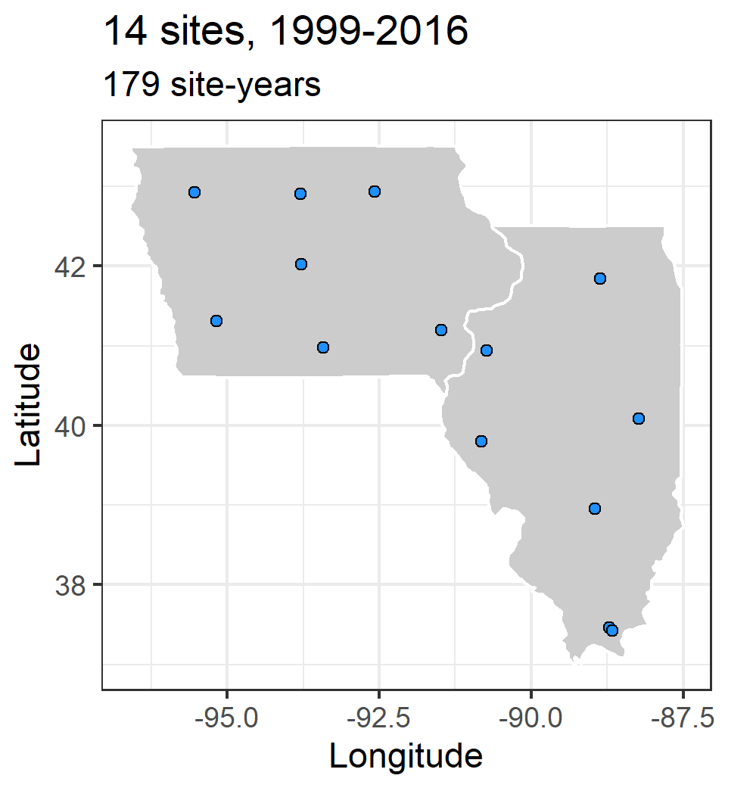
Notes:
To begin to tackle the problem we used a three-pronged approach. Literature review, modelling, and long-term multi-site replicated experimental data.

Slide 24
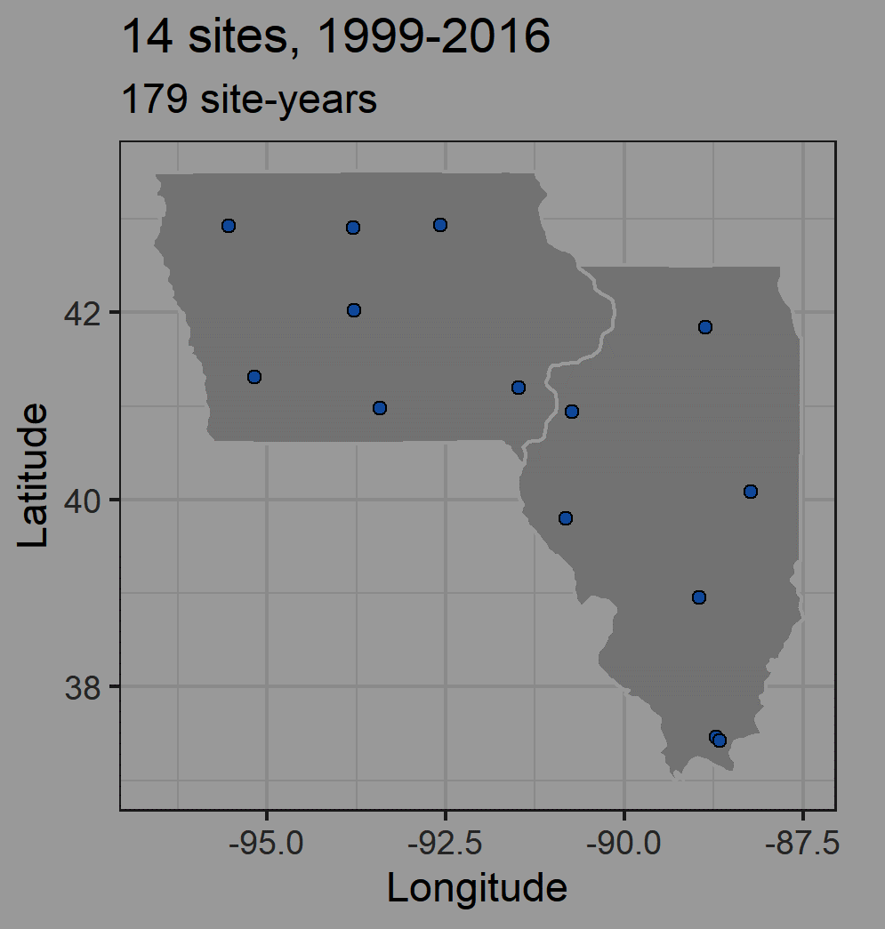
Notes:
To begin to tackle the problem we used a three-pronged approach. Literature review, modelling, and long-term multi-site replicated experimental data.

Slide 25
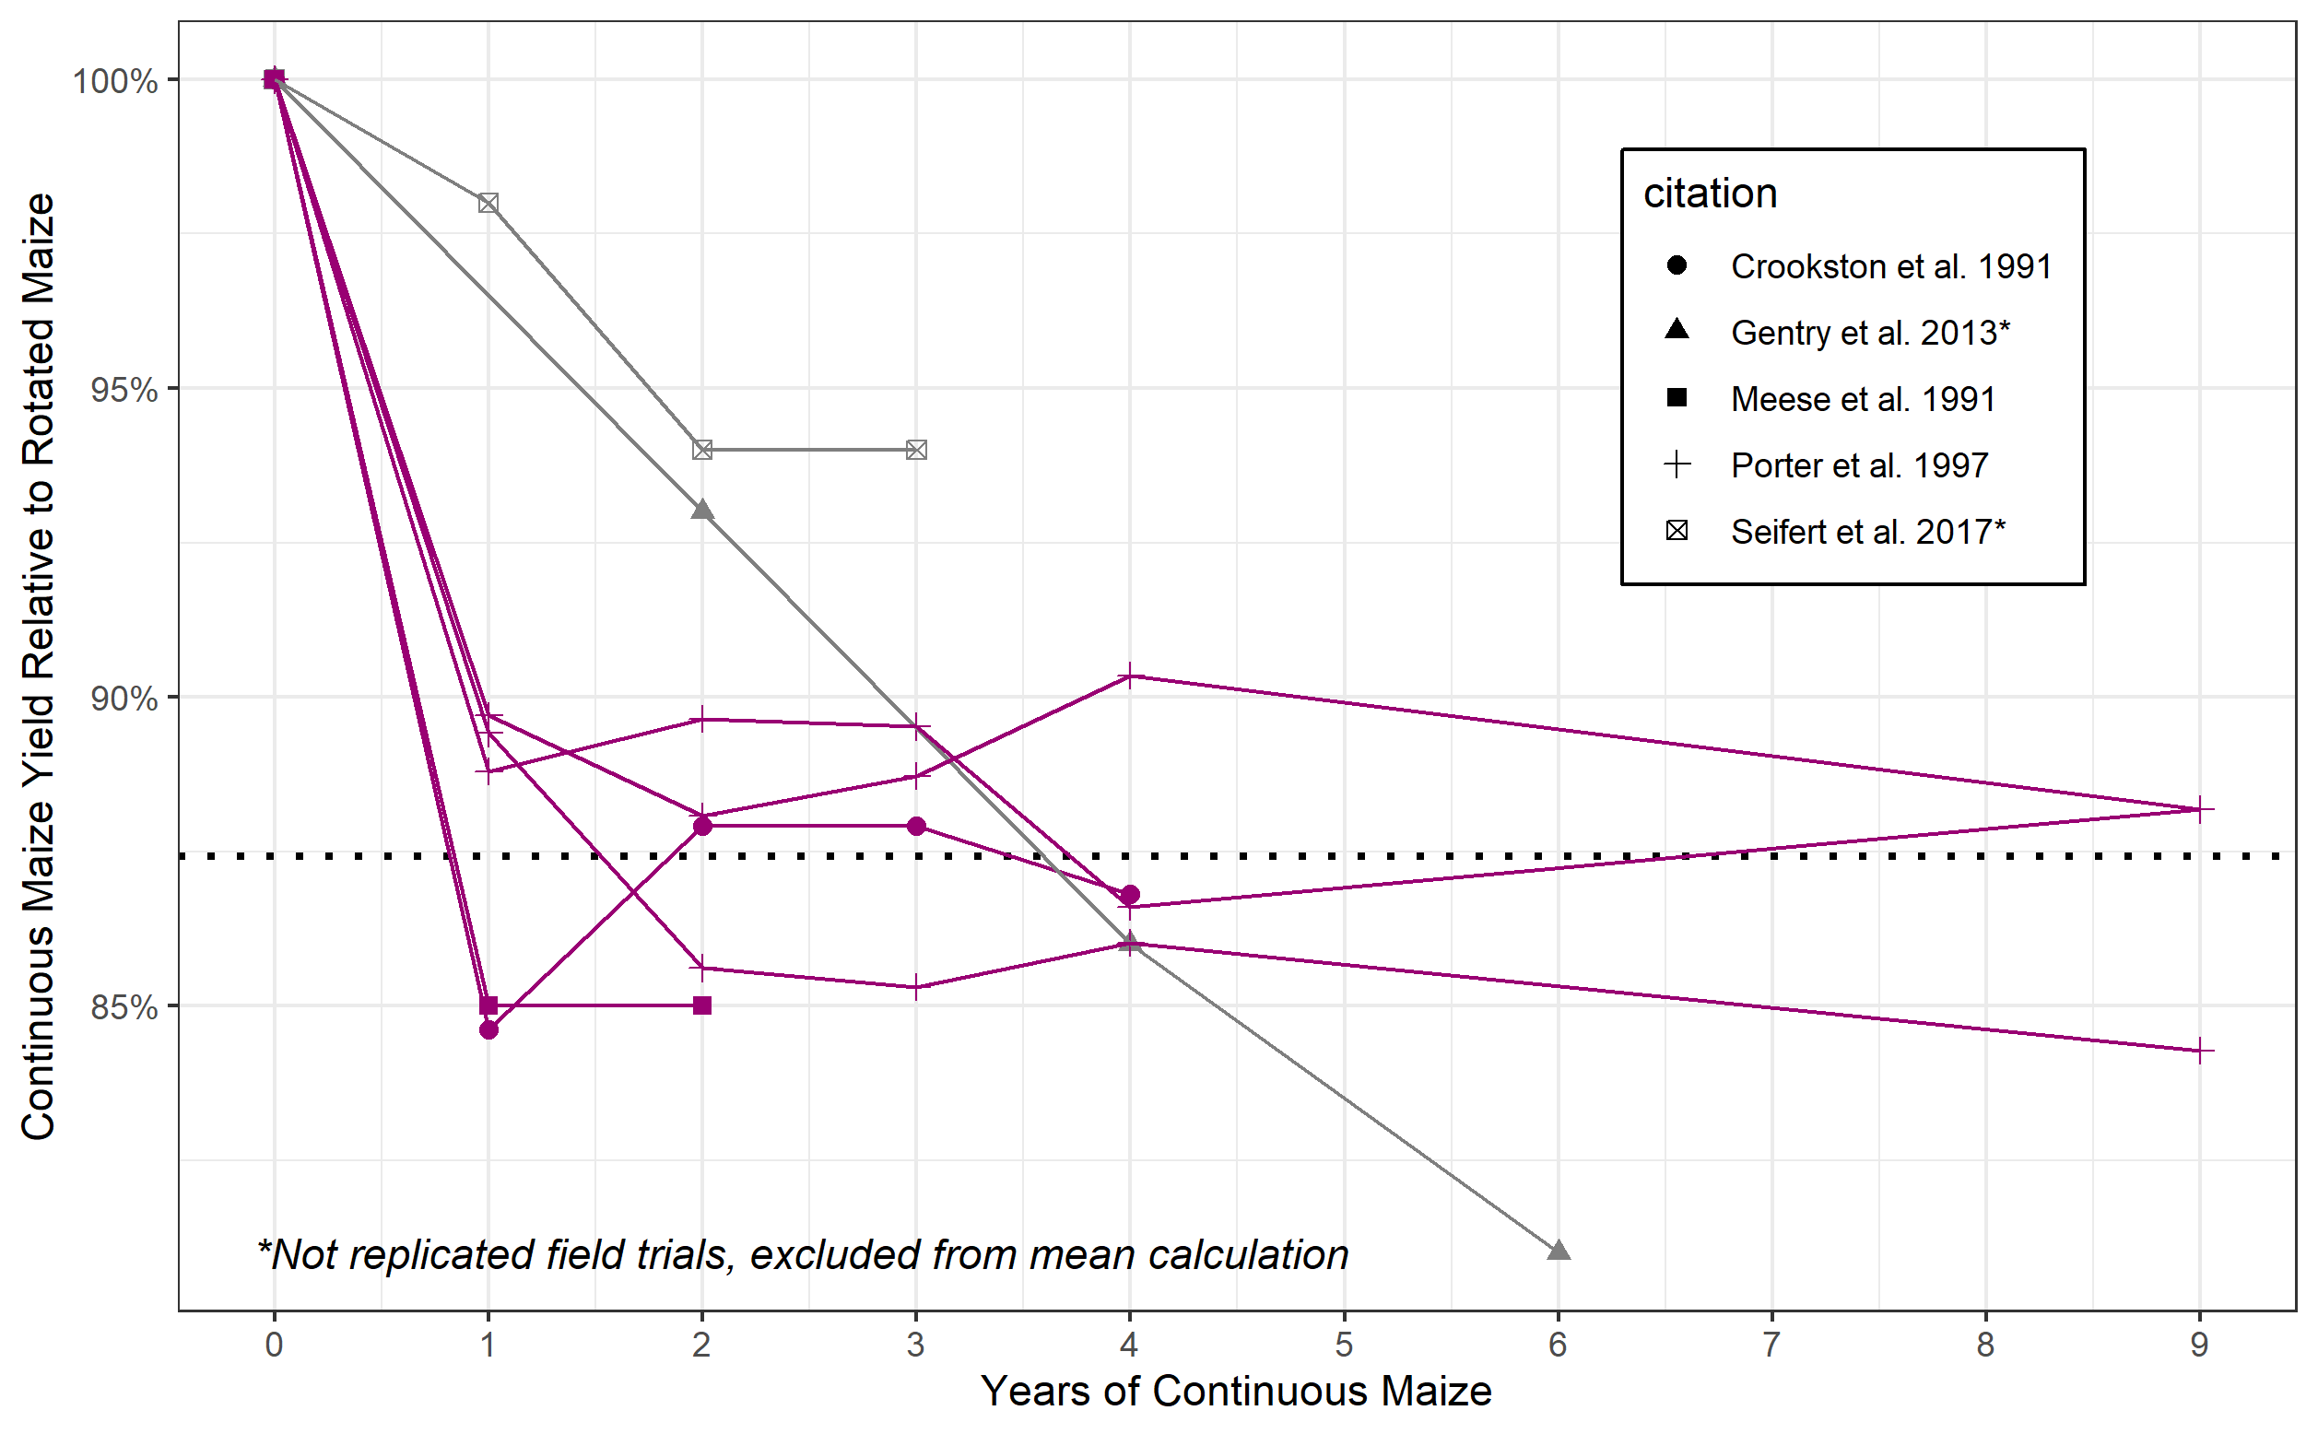
Notes:
The first question I had was whether there was evidence the penalty was related to the number of years in corn. I found three studies that had staggered start dates for the continuous corn treatment, which allowed them to de-confound weather and years in corn. I think this provided strong evidence the causes of the penalty do not accumulate, but are rather a one-year phenomenon and are only related to the previous year’s crop. Some of John Sawyer’s work has also supported this. So this allowed me to focus on thinking about the penalty only being a function of the previous year, which simplifies things drastically.

Slide 26
Hypothesis
Insufficient soil water recharge following corn
Altered nitrogen cycling
Seedling death
Delayed emergence
Foliar disease
Compromised root growth
Compromised root function
Decreased early plant growth
Notes:
I then extracted a list of hypotheses. These are things that have been suggested, some have been tested but only greenhouses or one or two seasons, and in some cases came from asking agronomists and farmers what they thought.

Slide 27
Notes:
To begin to tackle the problem we used a three-pronged approach. Literature review, modelling, and long-term multi-site replicated experimental data.

Slide 28

https://www.apsim.info/
https://www.apsim.info/apsim-downloads-for-17-18/
Notes:
APSIM is a process-based model that is widely used across the globe, and largely due to efforts at Iowa State University it has been validated and applied extensively in Midwestern systems.

Slide 29

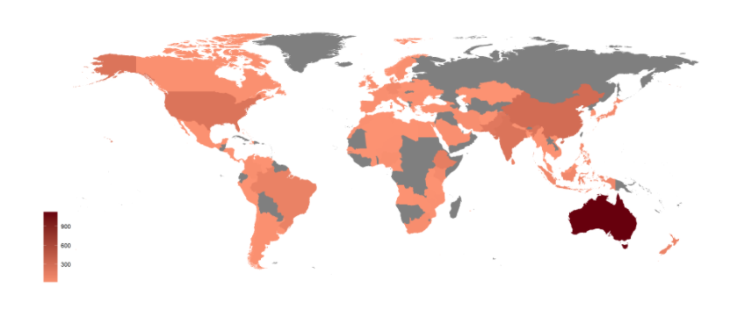
https://www.apsim.info/
Used in 116 countries, ~2000 users
Validated and applied in Midwestern systems
https://www.apsim.info/apsim-downloads-for-17-18/
Notes:
APSIM is a process-based model that is widely used across the globe, and largely due to efforts at Iowa State University it has been validated and applied extensively in Midwestern systems.

Slide 30
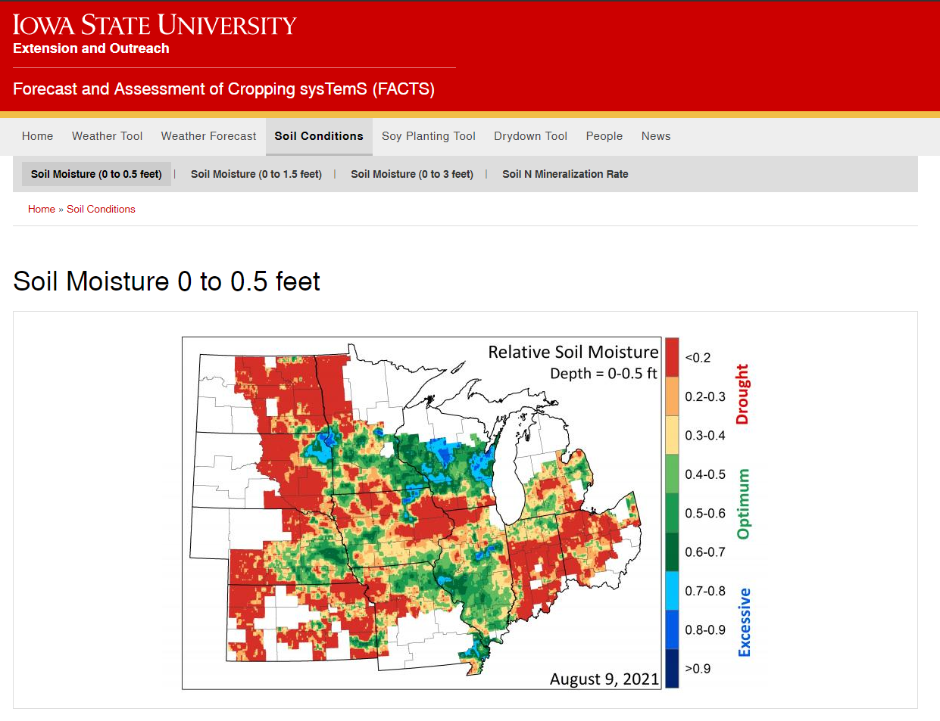
https://crops.extension.iastate.edu/facts/soil-moisture-15cm

Slide 31
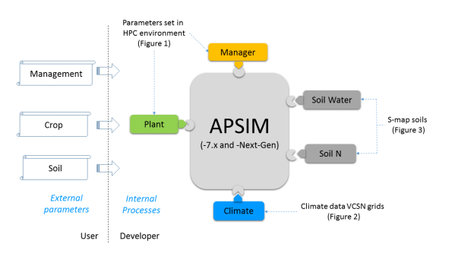
APSIM?

Slide 32
Hypothesis
Insufficient soil water recharge following corn
Altered nitrogen cycling
Seedling death
Delayed emergence
Foliar disease
Compromised root growth
Compromised root function
Decreased early plant growth
Notes:
I then extracted a list of hypotheses. These are things that have been suggested, some have been tested but only greenhouses or one or two seasons, and in some cases came from asking agronomists and farmers what they thought.

Slide 33
Hypothesis | Model
Insufficient soil water recharge following corn | Can test
Altered nitrogen cycling | In progress…
Seedling death | Change planting density
Delayed emergence | Change sowing depth
Foliar disease | Change plant parameter
Compromised root growth | Change plant parameter
Compromised root function | Change plant parameter
Decreased early plant growth | Change plant parameter

Slide 34
Hypothesis | Model
Insufficient soil water recharge following corn | Can test
Altered nitrogen cycling | In progress…
Seedling death | Change planting density
Delayed emergence | Change sowing depth
Foliar disease | Change plant parameter
Compromised root growth | Change plant parameter
Compromised root function | Change plant parameter
Decreased early plant growth | Change plant parameter

Slide 35
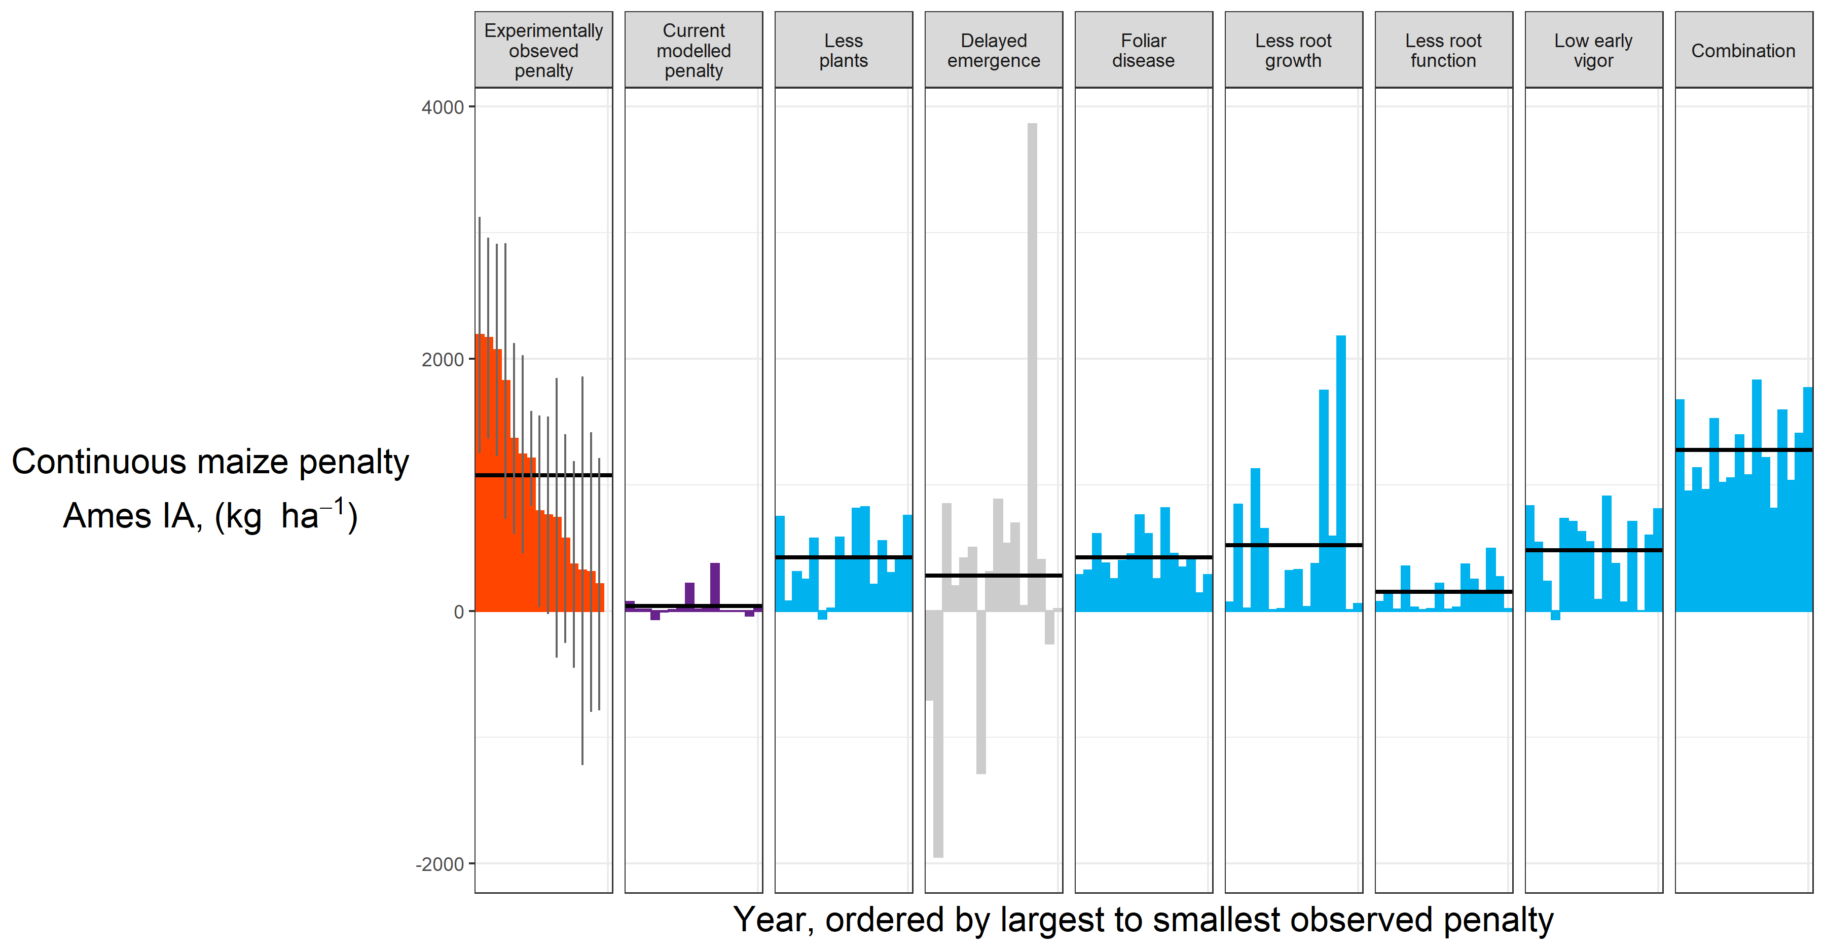
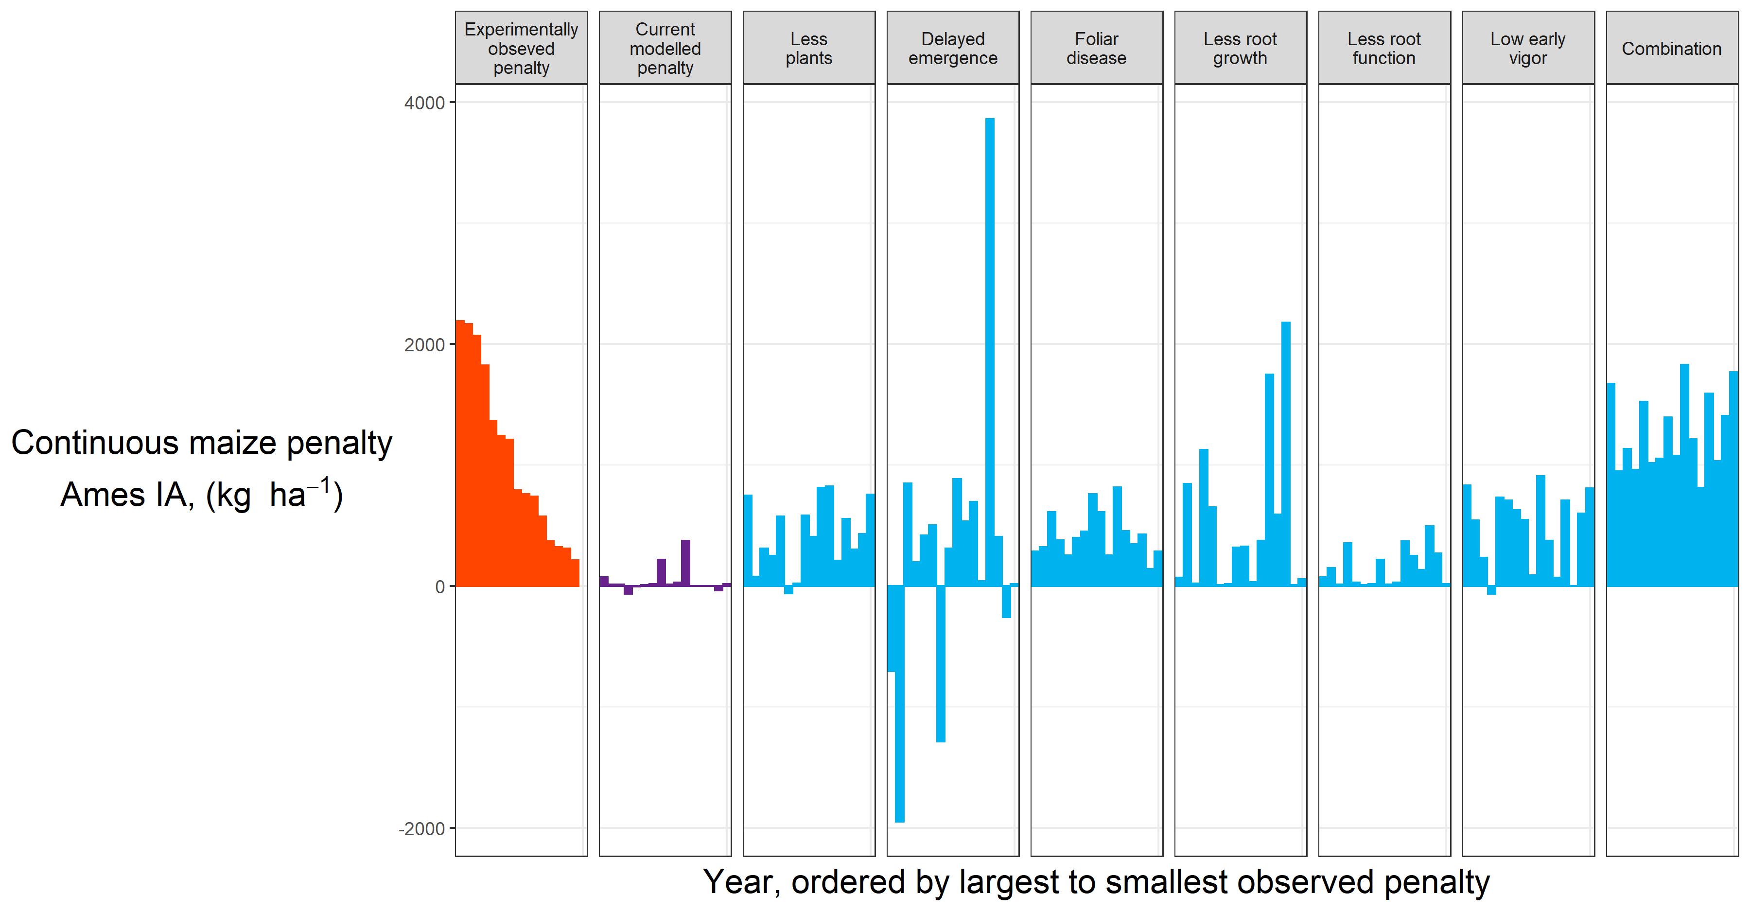
Results

Slide 36

Results
Notes:
If you look at the mean penalty, all of the scenarios produce fairly reasonable results. But if you look at the variation, it seems the delayed emergence is not, at least consistently, a likely candidate.

Slide 37
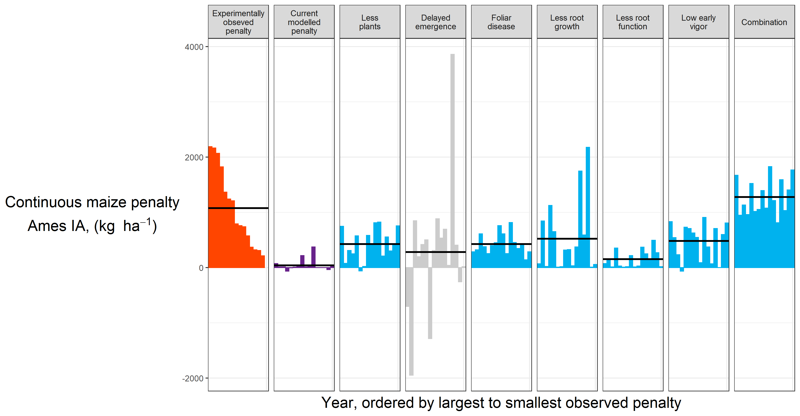
Results

Slide 38
Results
What does the data say?

Slide 39
Notes:
To begin to tackle the problem we used a three-pronged approach. Literature review, modelling, and long-term multi-site replicated experimental data.

Slide 40
Notes:
Many states maintain a network of experiments looking at how corn responds to nitrogen (agronomists!). John Sawyer and Emmerson Nafziger, both now retired, managed Iowa and Illinois’ sites, respectively. Each site had a corn-soybean rotation, and a continuous corn rotation, each receiving 3-7 different nitrogen treatments, and replicated at least three times. We used these nitrogen-response curves to estimate the continuous corn penalty for each year at each site.

Slide 41
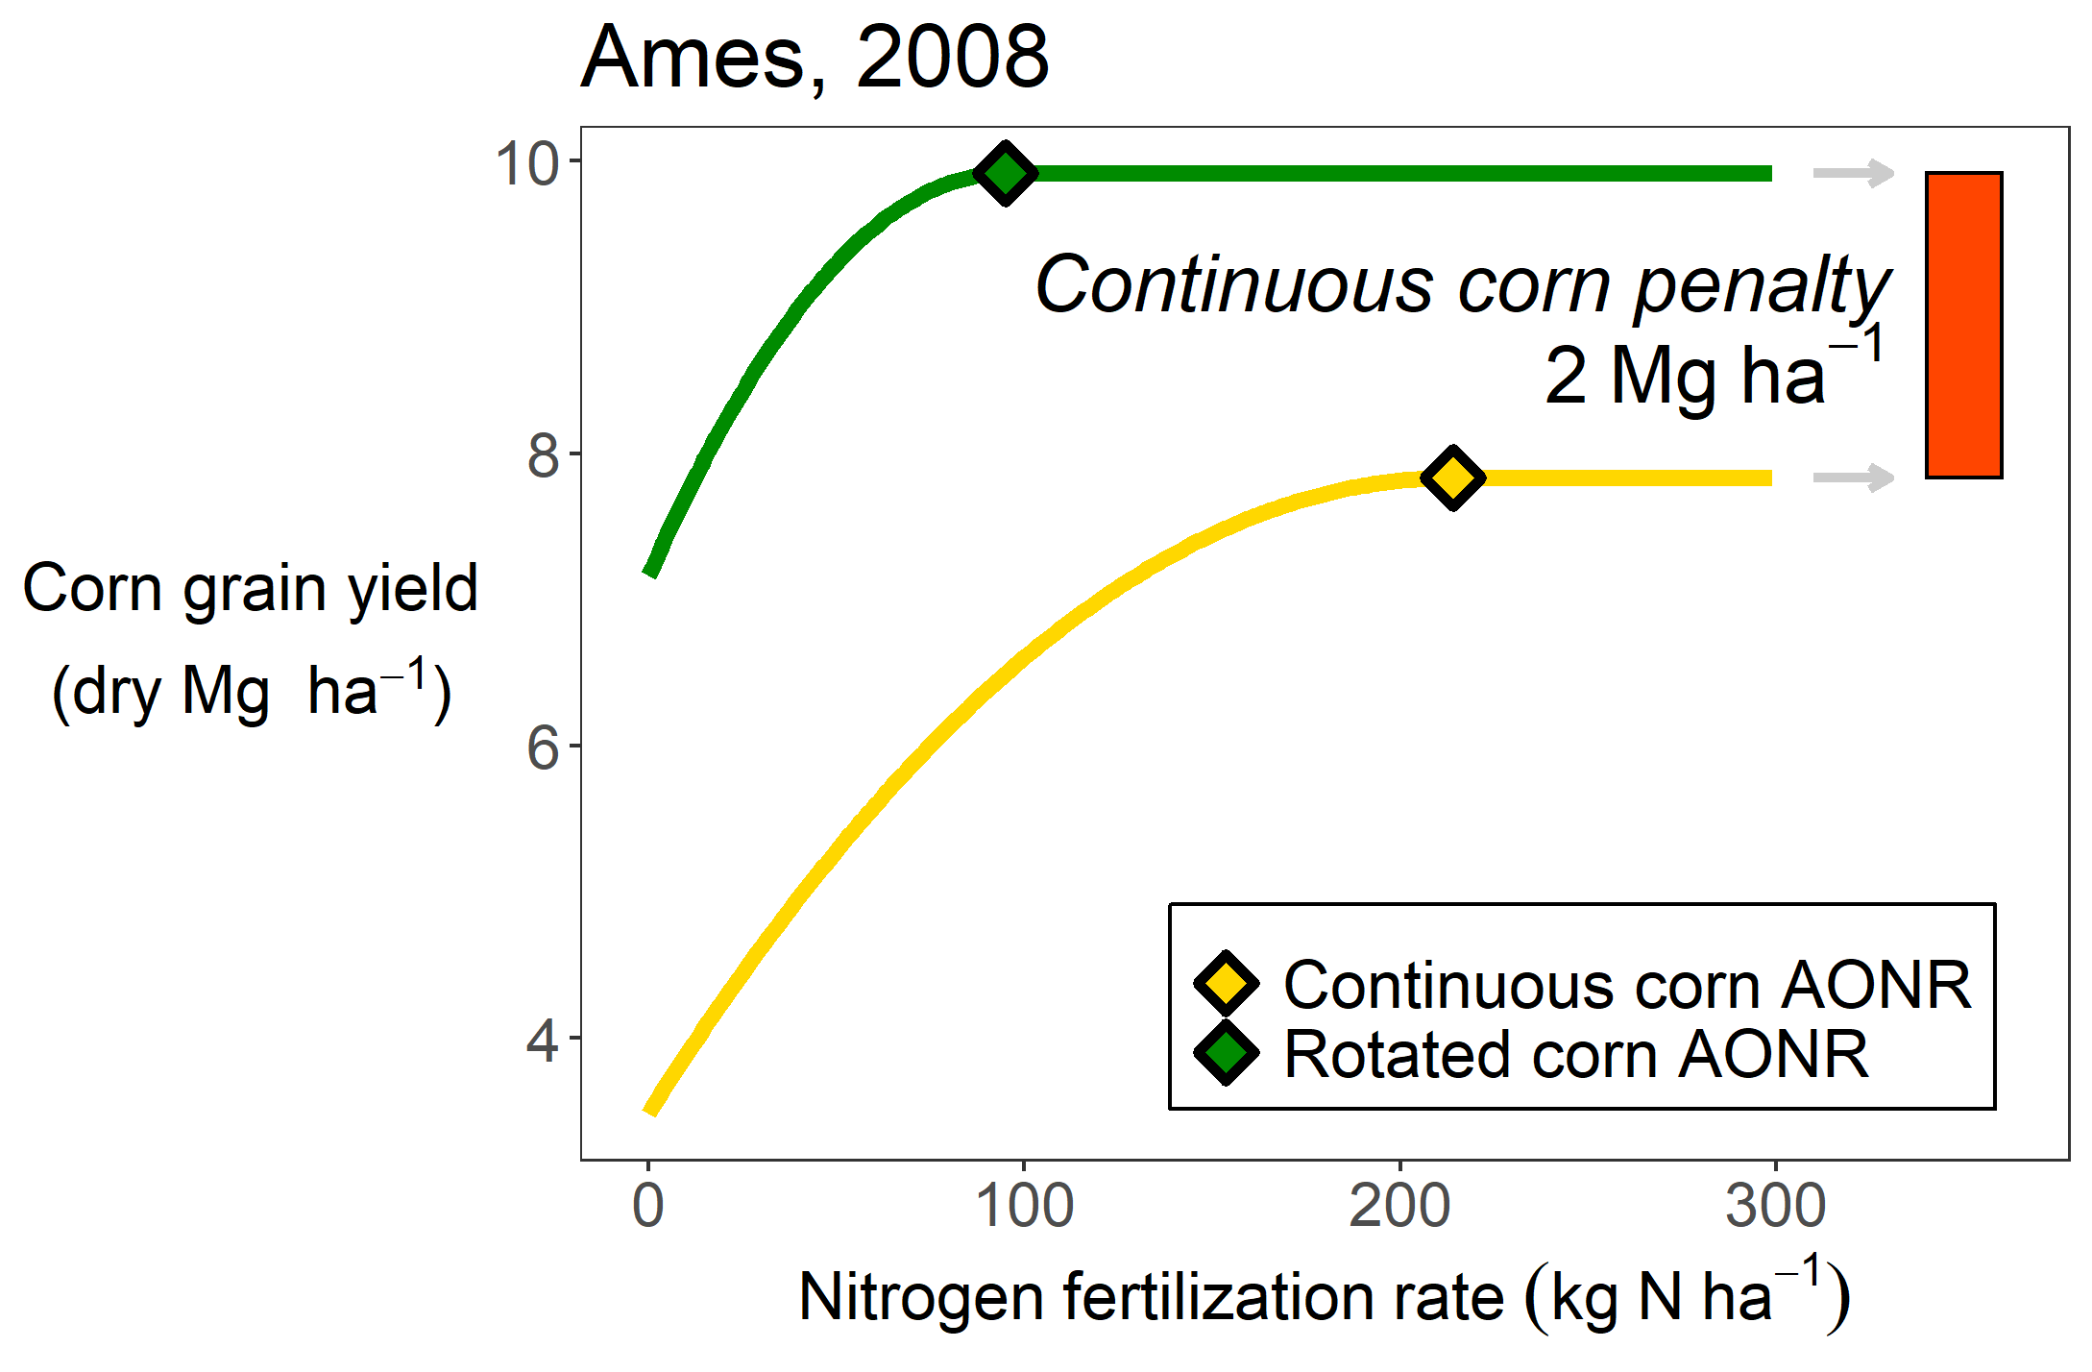
Notes:
Many states maintain a network of experiments looking at how corn responds to nitrogen (agronomists!). John Sawyer and Emmerson Nafziger, both now retired, managed Iowa and Illinois’ sites, respectively. Each site had a corn-soybean rotation, and a continuous corn rotation, each receiving 3-7 different nitrogen treatments, and replicated at least three times. We used these nitrogen-response curves to estimate the continuous corn penalty for each year at each site.

Slide 42
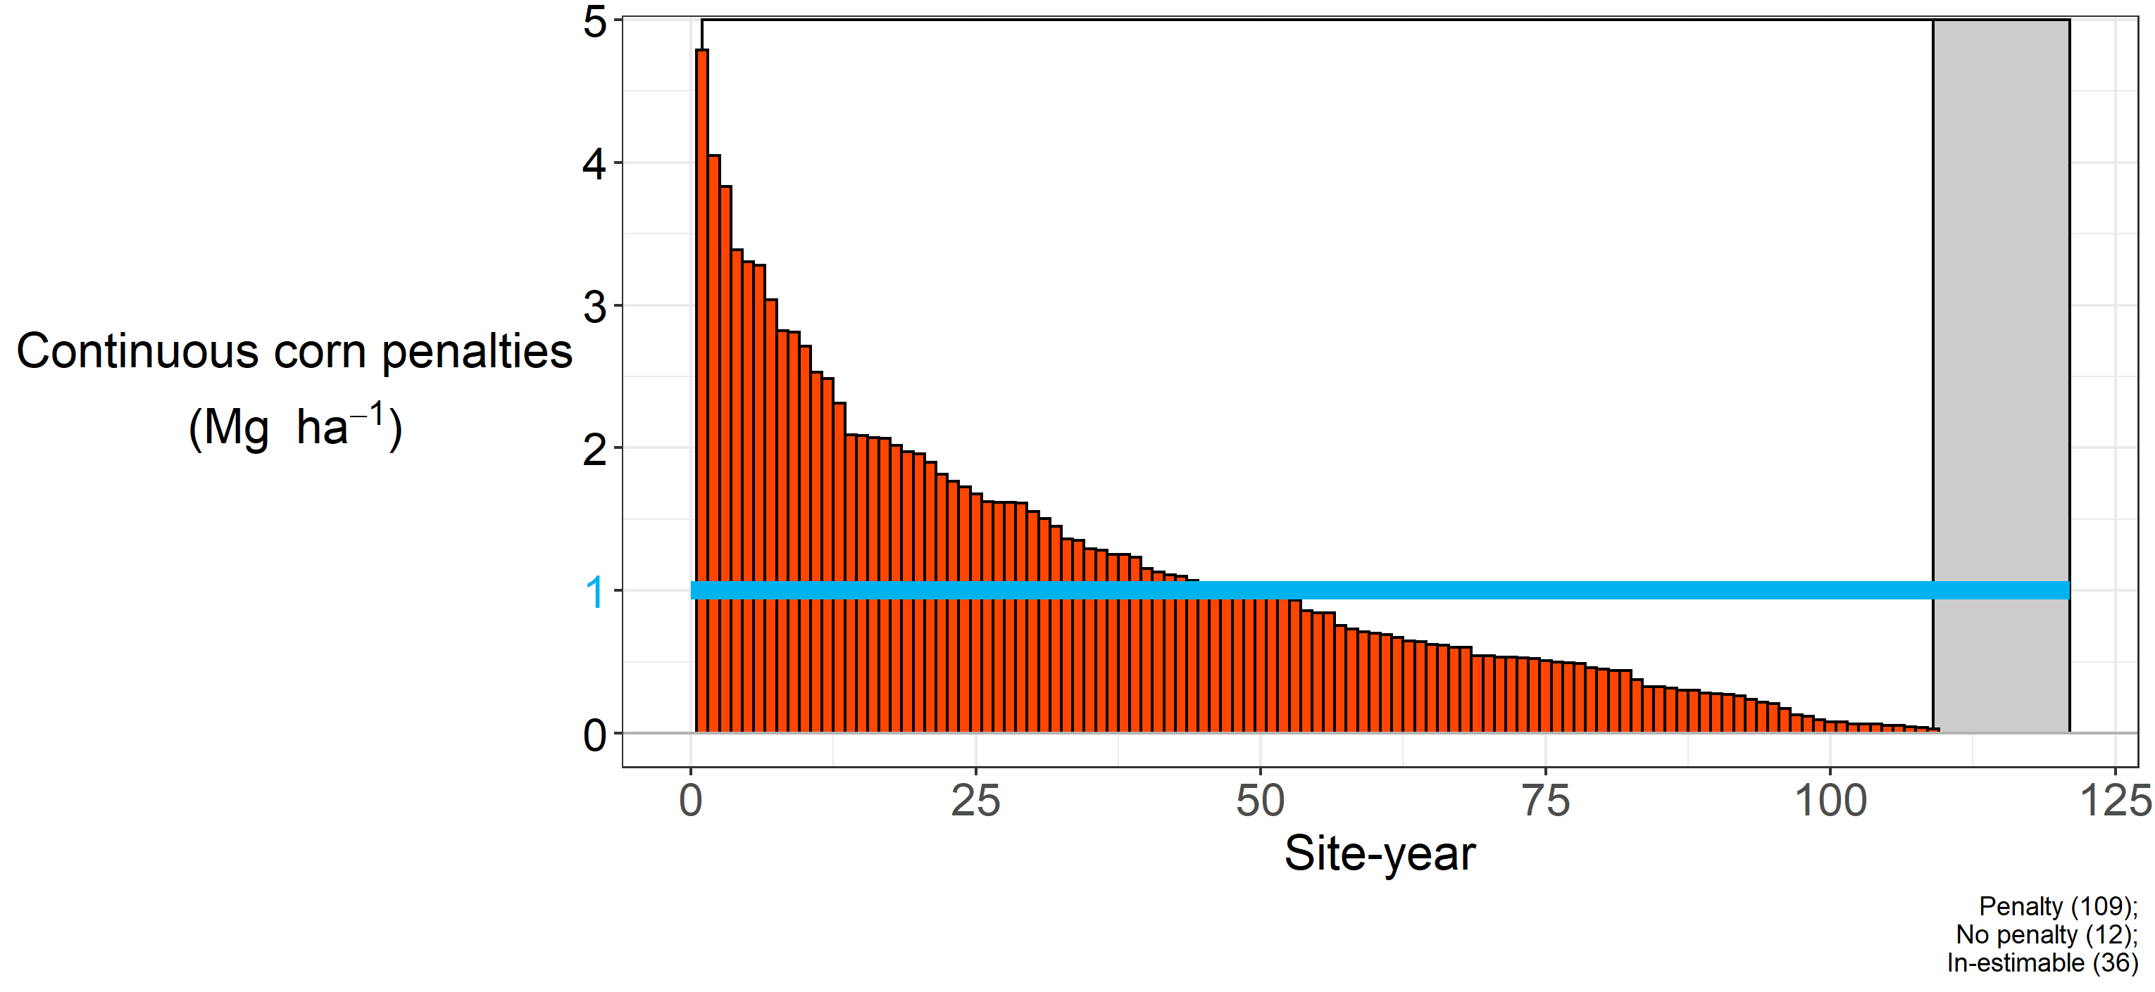
Notes:
Again here’s a little reminder of how I’m calculating this penalty. You can see that even after applying more N, over 90% of the environments had a continuous corn penalty (in 12 cases, adding more nitrogen completely closed the yield gaps). The blue line represents the statistical mean, at 1 Mg ha-1 (roughly 20 bushels).

Slide 43
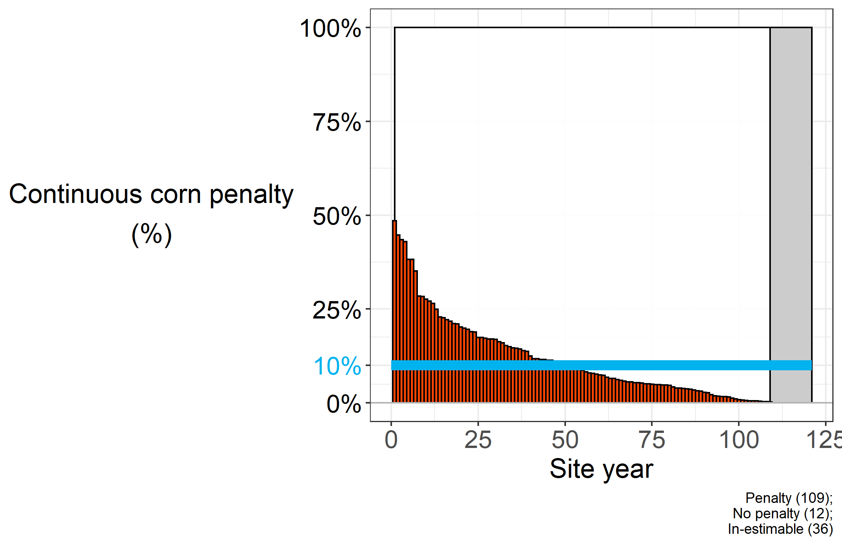
Notes:
SO the continuous corn penalty will knock back your corn yields, on average, about 10%. But there is a lot of variation in that value. Some years you get close to half the corn yields, some years close to the same. So…can we get an idea of what is associated with that variation?

Slide 44

Photo credit: https://laductrading.com/why-dont-women-fish/

Slide 45
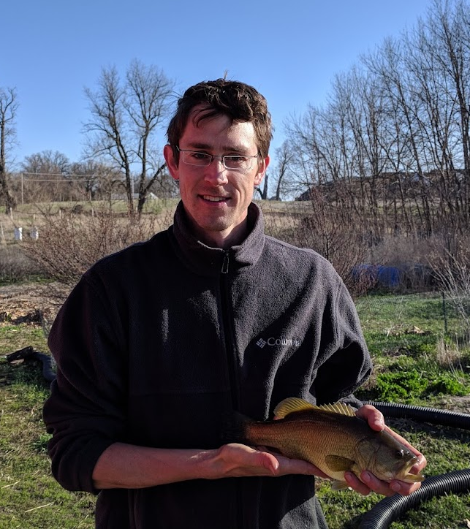
Cold days
Amount of rain before planting
Residue

Slide 46
Results

Slide 47
Results
Our dataset
Other studies

Slide 48
Results
~
Our dataset
Other studies

Slide 49
Results
~
Our dataset
Other studies

Slide 50
Results
~
Our dataset
Other studies

Slide 51
Results
~
~
Our dataset
Other studies
~

Slide 52
Results
~
~
~
Our dataset
Other studies
~
~

Slide 53
Results
~
~
~
~
Our dataset
Other studies
~
~
?
Notes:
Seedling diseases are more pronounced in wet and cool conditions. But to my knowledge no one has done a growth analysis on corn grown in rotation and monoculture, so we have no idea if there is a consistent difference in growth patterns. Additionally, I haven’t seen any data on kernel number or kernel weight – these are basic agronomic measurements that could be done easily and could provide a lot of information about what is happening to the plants.

Slide 54
Results
Notes:
Seedling diseases are more pronounced in wet and cool conditions. But to my knowledge no one has done a growth analysis on corn grown in rotation and monoculture, so we have no idea if there is a consistent difference in growth patterns. Additionally, I haven’t seen any data on kernel number or kernel weight – these are basic agronomic measurements that could be done easily and could provide a lot of information about what is happening to the plants.

Slide 55
Results
Dynamically change the parameters?

Slide 57
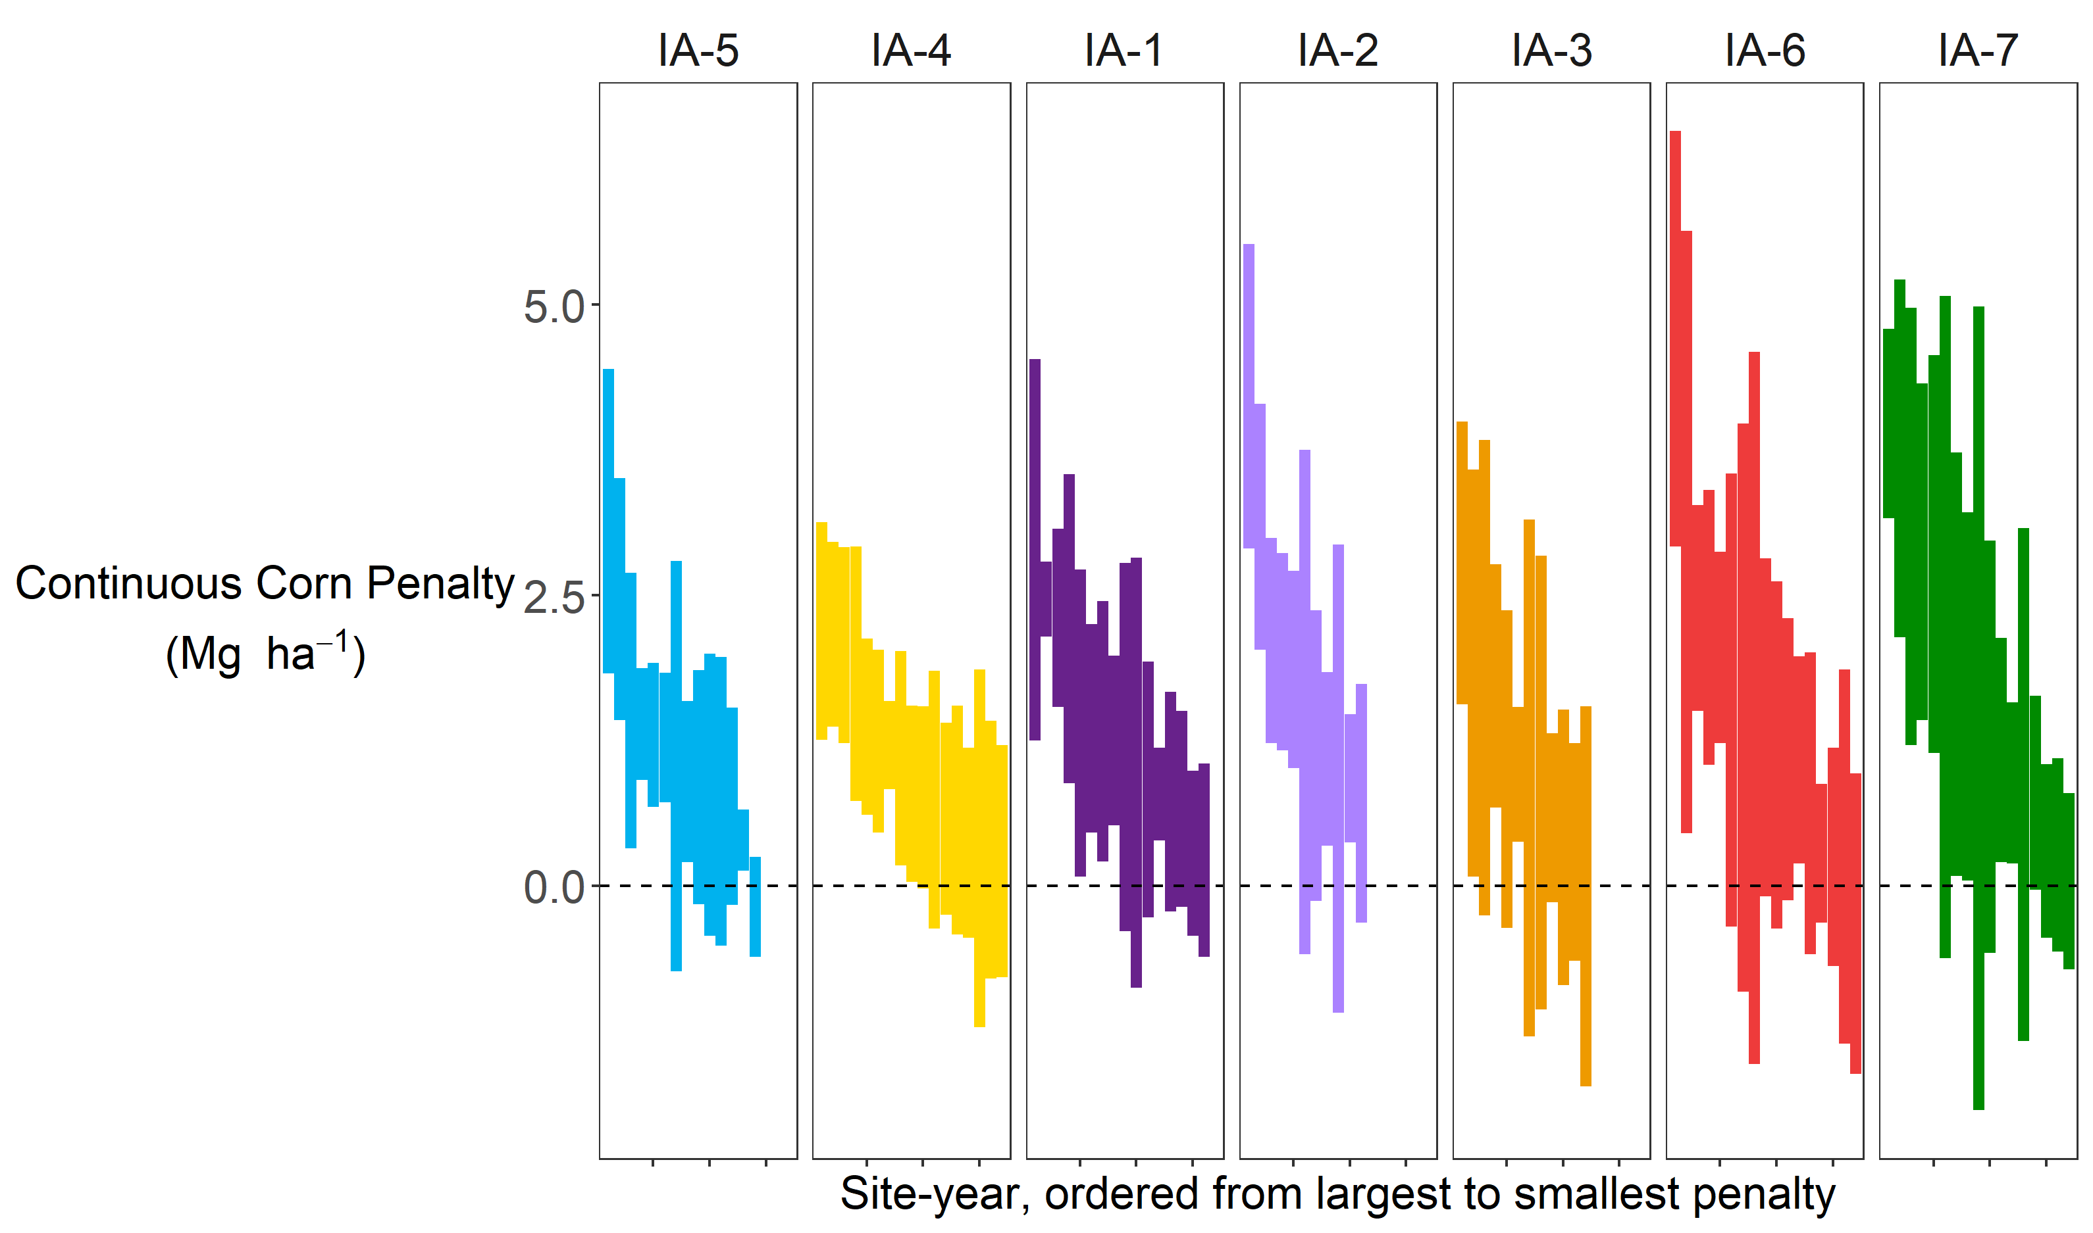
Noise from plot harvester
Noise between replicates
Noise from management
…
Notes:
Plot harvesters aren’t perfect, there’s some error associated with the number they spit out. Then of course there’s the spatial variability of fields such that two replicates with the same exact treatment aren’t going to produce the same exact yields. There’s also the question of management. Weeds can be a serious problem in monocultures, and while we are assuming weeds are adequately controlled, whether this is true might depend on the year, or the manager, or the weed pressure at that site.

Slide 58
Maximum rooting depth
Growth analysis
Yield components
Surface residue at planting

Slide 60

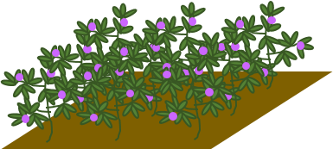

Slide 61
Suite of field msmts

Slide 62
Yields, root depth, root mass?

Slide 63
What I did
Why I did it

Slide 65


Slide 66
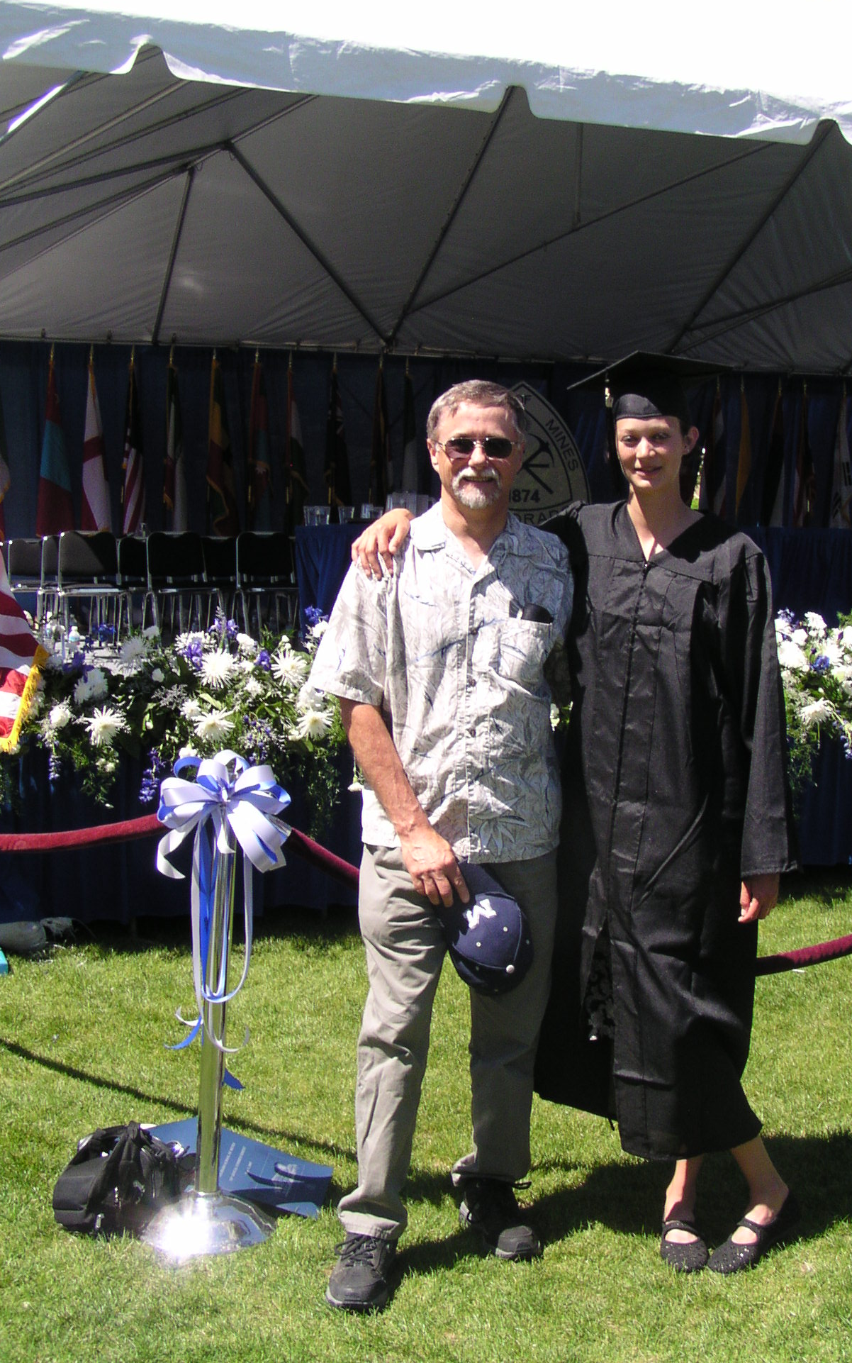

Slide 67


Slide 68
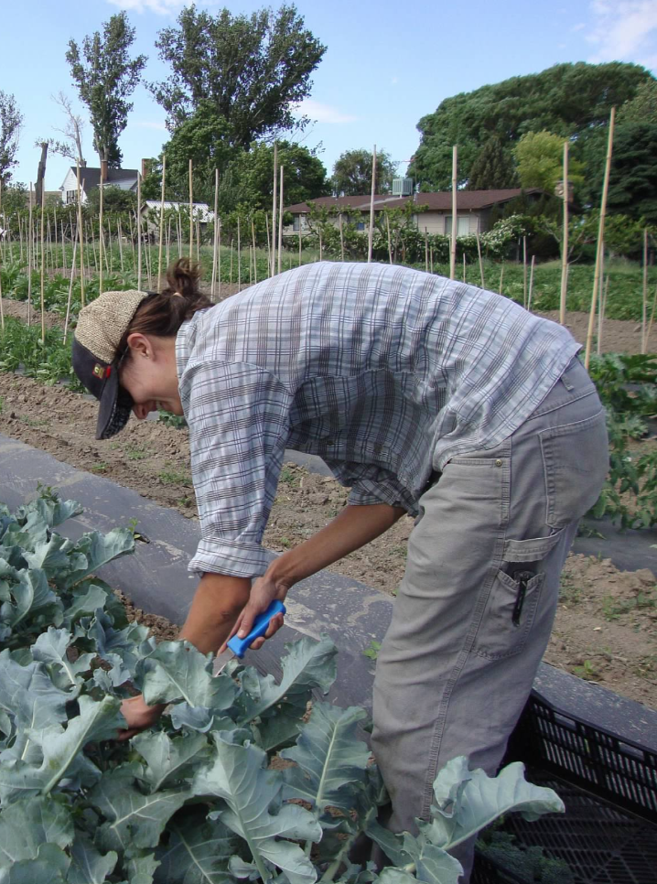

Slide 69
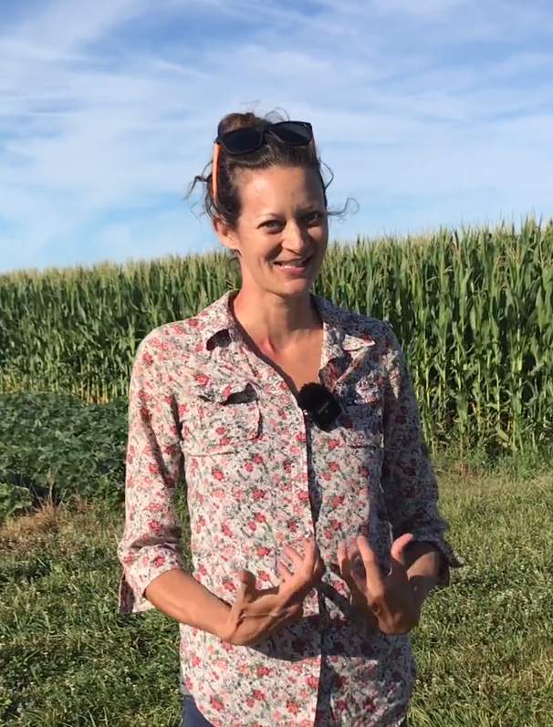

Slide 70
How can agriculture be done such that the farmer, their community, society, and the environment all benefit.

Slide 71
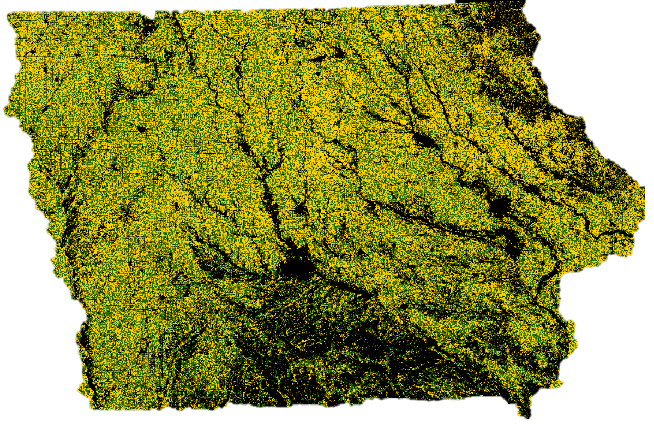
Notes:
Soil erosion. The very first question of sustainability, and our cropping systems fail it. We are losing soil faster than we are creating it. Additionally, soil is shifting (we are just losing production potential, it’s not increasing production potential where it goes). Water quality almost goes without saying. Air quality. Iowa ranks 49th in public land holdings at 0.2%.

Slide 72
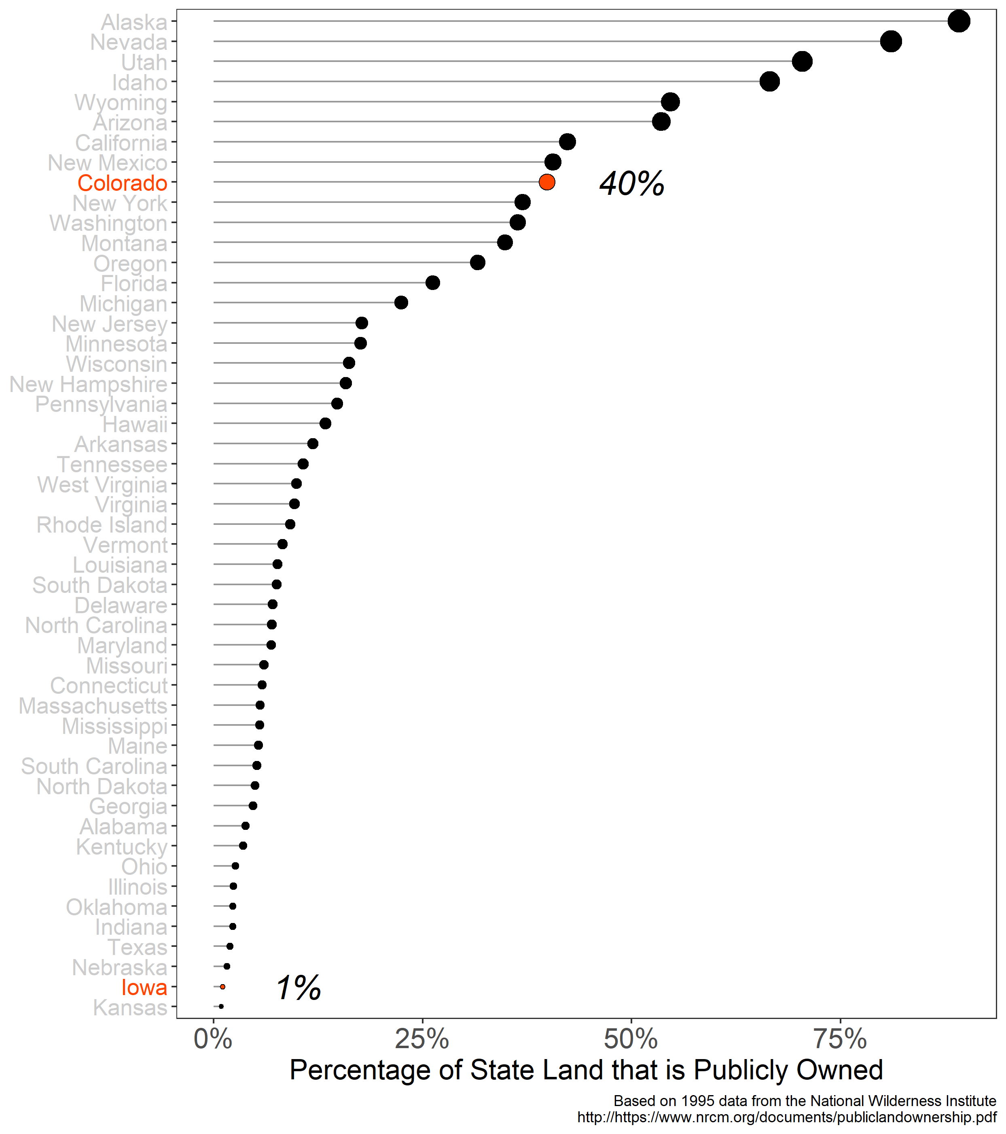

Slide 73
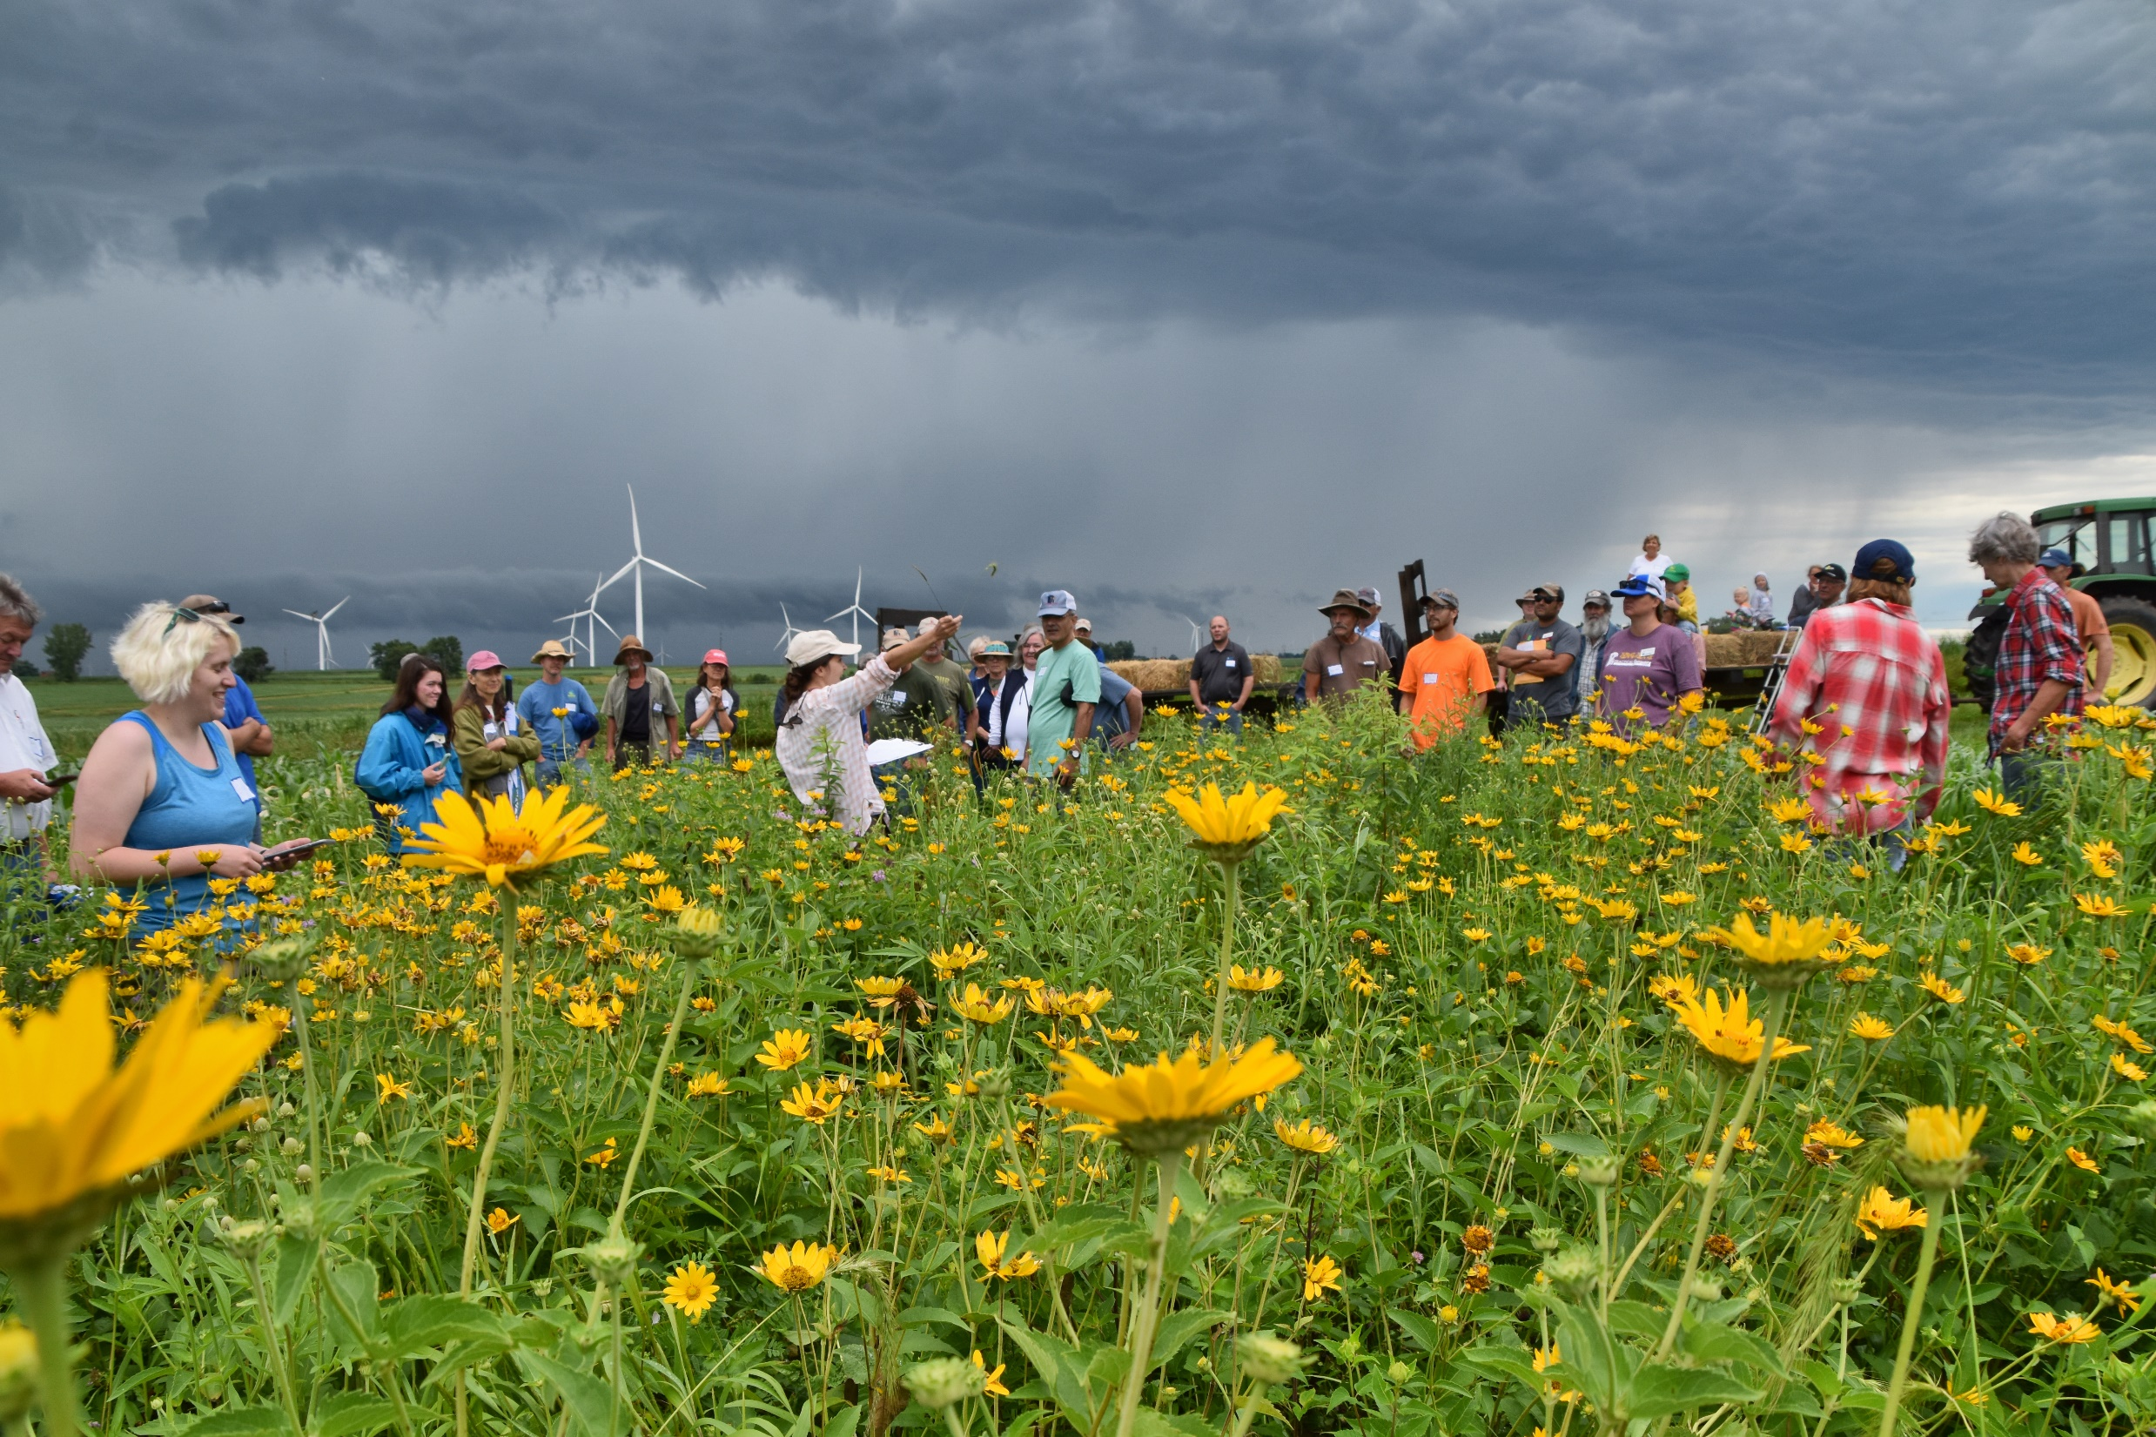

Slide 74
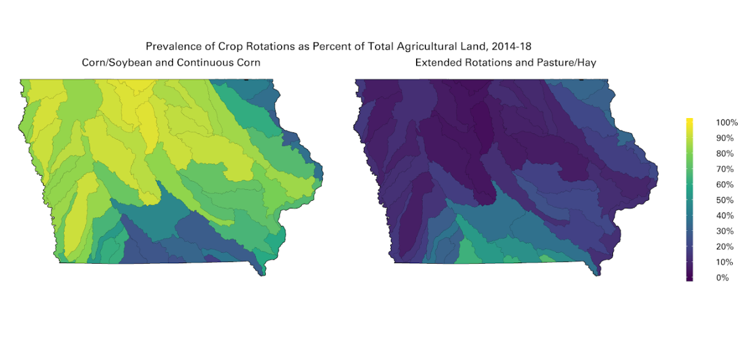
Courtesy of Laurie Nowatzke
Data Source: https://www.nass.usda.gov/Research_and_Science/Cropland/Release/index.php

Slide 75
Courtesy of Laurie Nowatzke
Data Source: https://www.nass.usda.gov/Research_and_Science/Cropland/Release/index.php

Slide 76
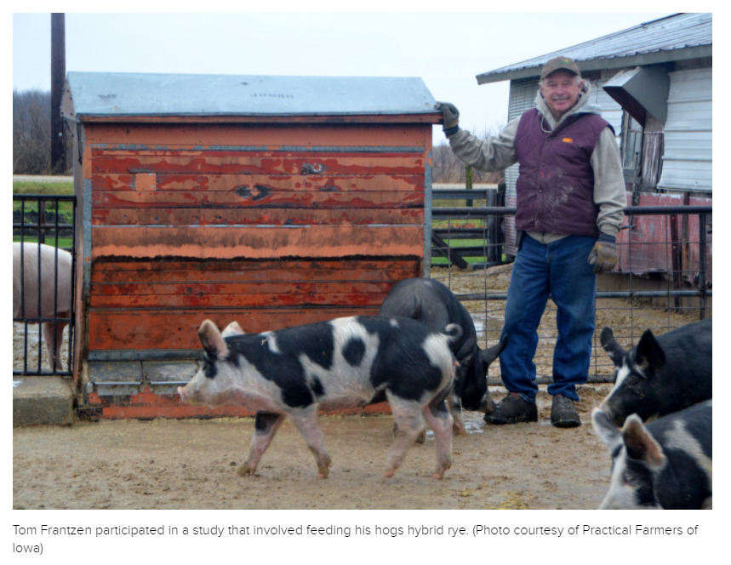
https://civileats.com/2021/08/10/hybrid-rye-is-helping-farmers-fight-superweeds-without-herbicide/

Slide 77
https://civileats.com/2021/08/10/hybrid-rye-is-helping-farmers-fight-superweeds-without-herbicide/
…In Europe, hybrid rye was developed by university researchers working with KWS. Tom Frantzen is thrilled that he has a new rotational crop, but concerned that it’s not based on homegrown science. “Why isn’t this work being done in the Midwest?” he asks.

Slide 78
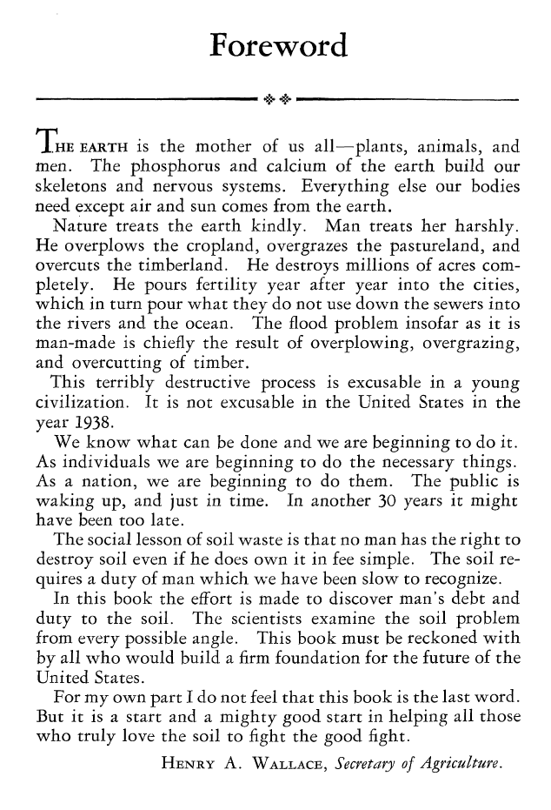

Slide 79
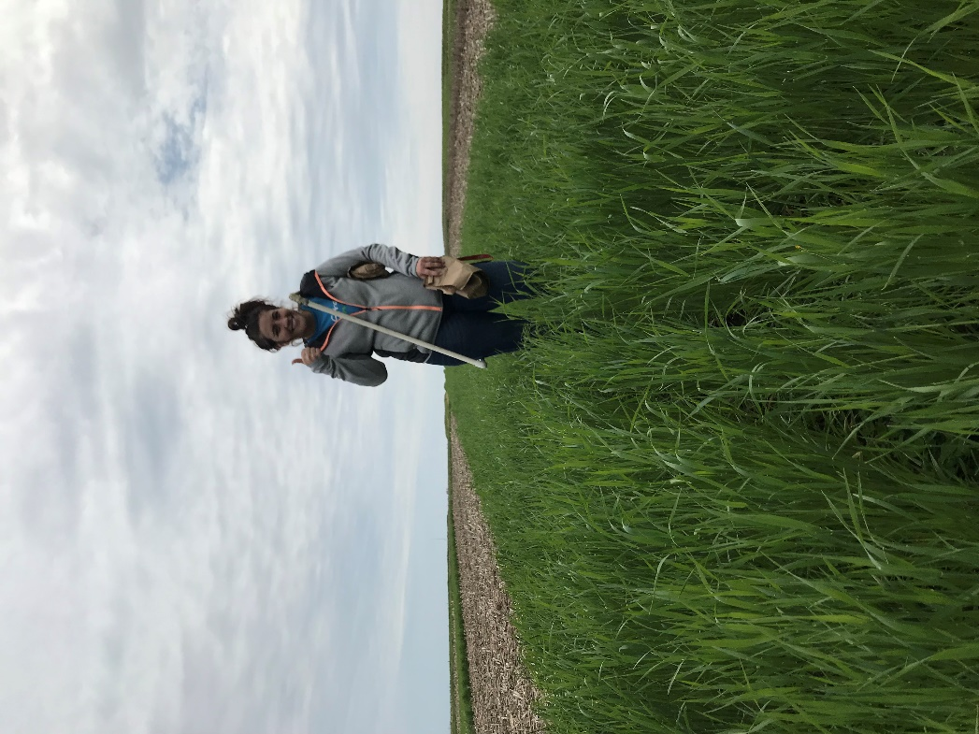
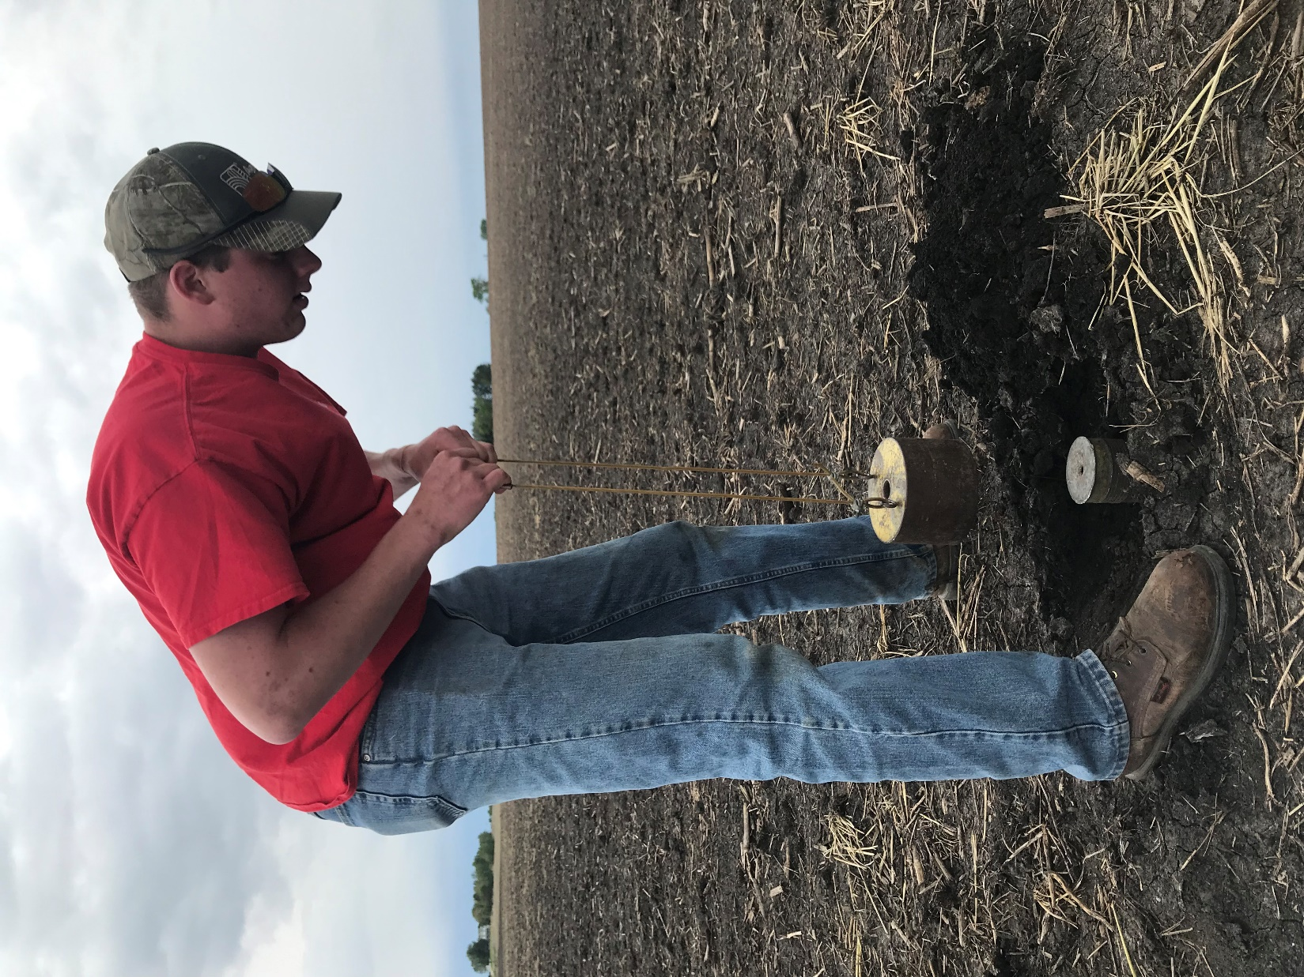
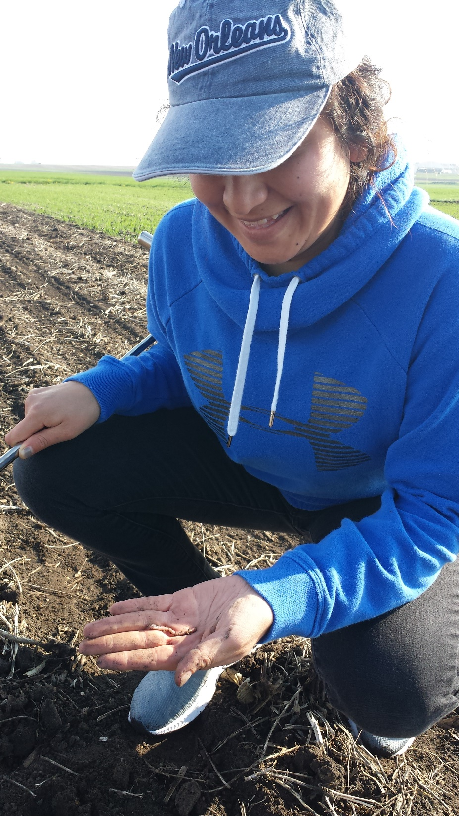

Slide 80
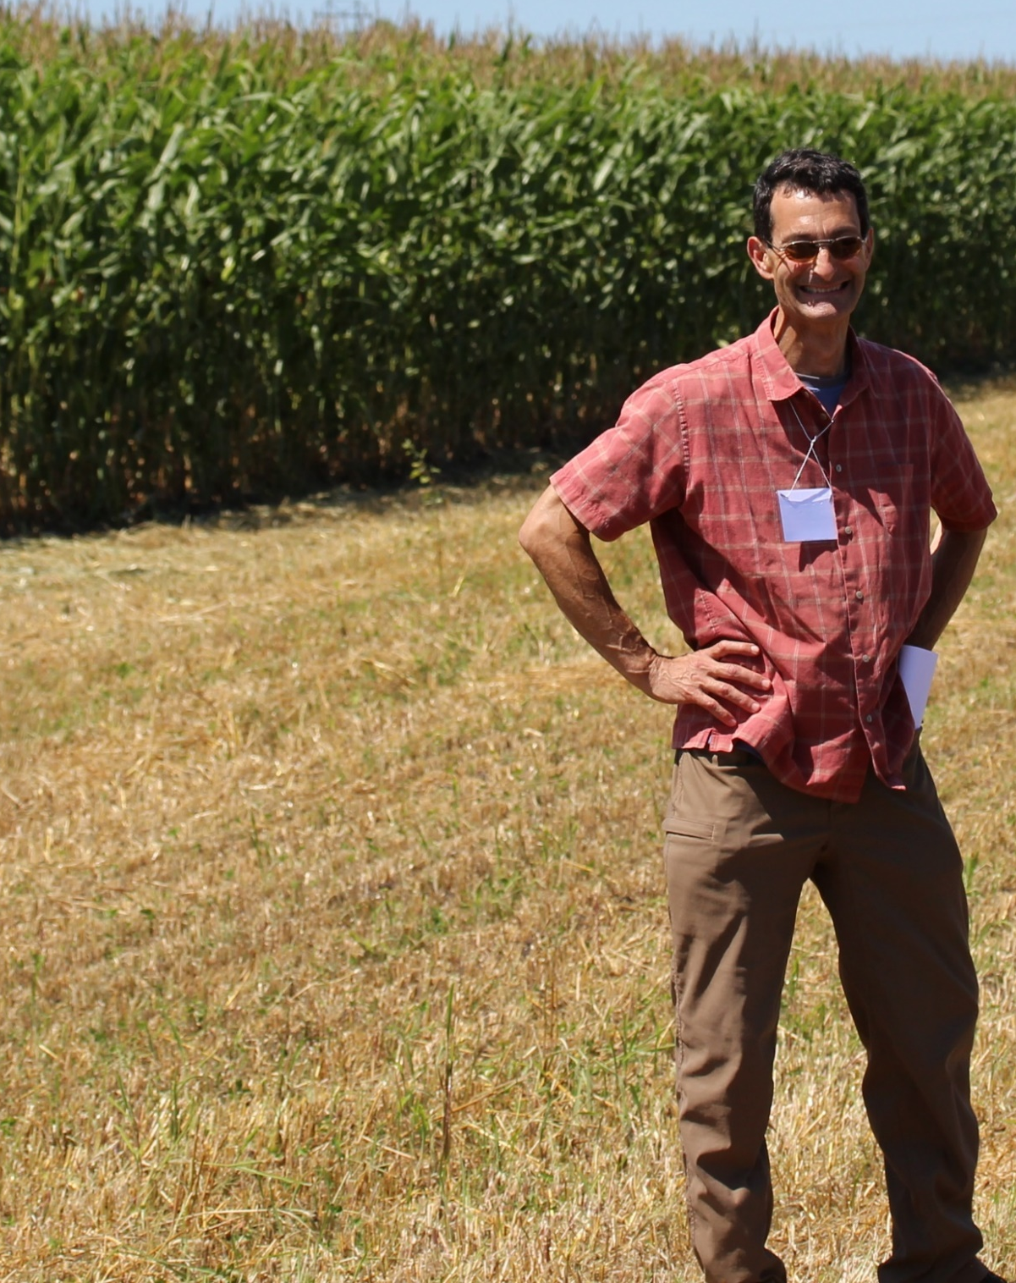
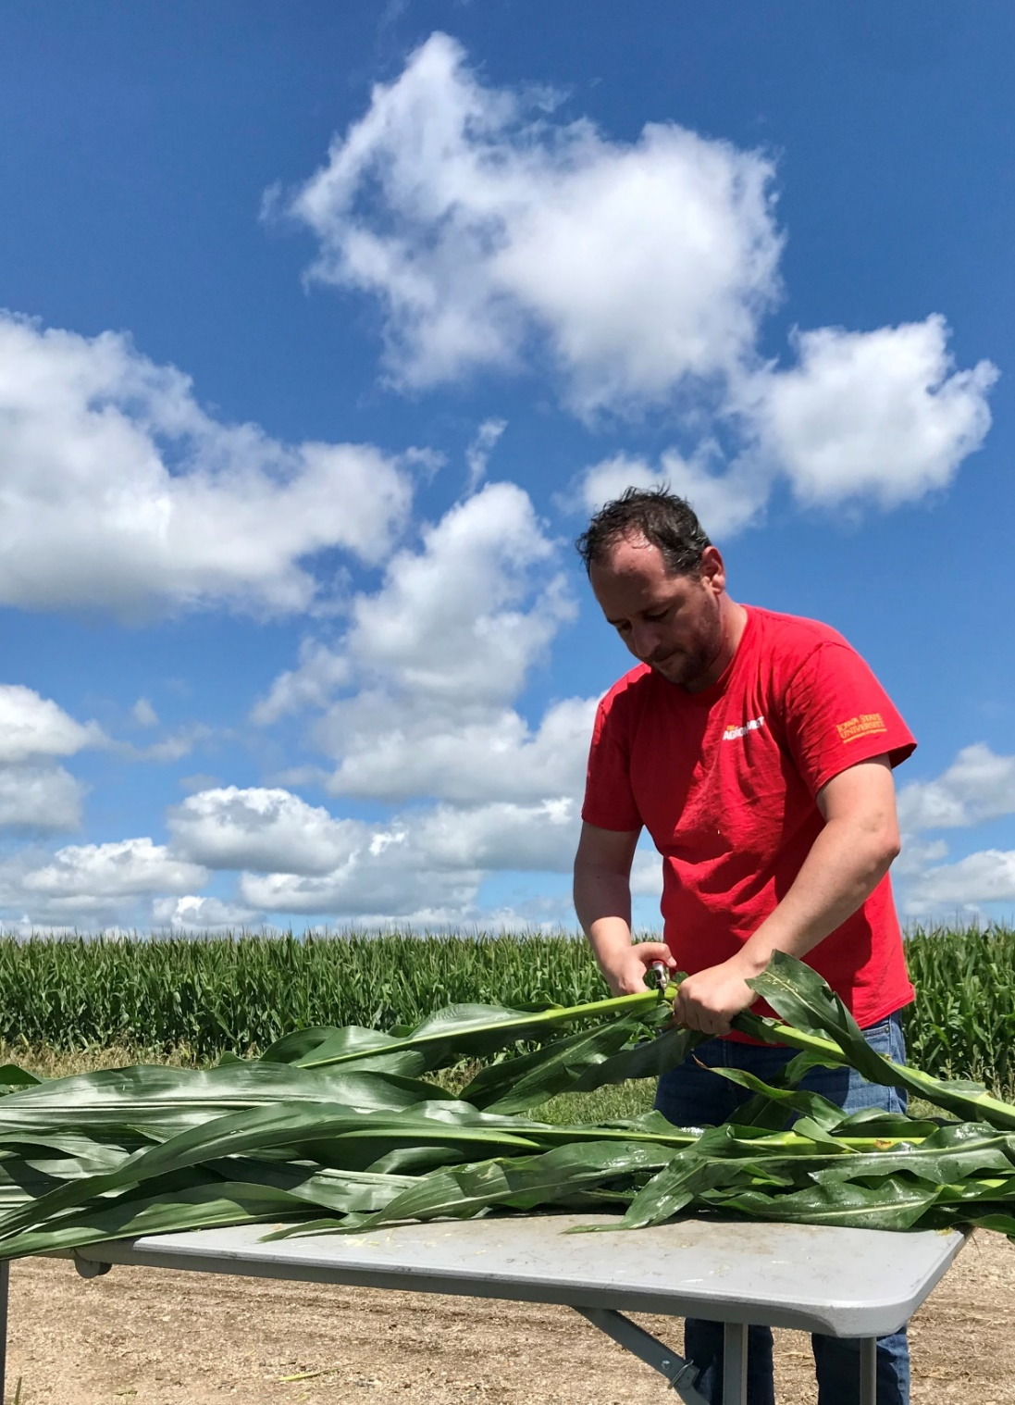
Sotirios Archontoulis
Assistant Professor
Agronomy Dept.
Iowa State University
Matt Liebman
Professor
Agronomy Dept.
Iowa State University

Slide 81
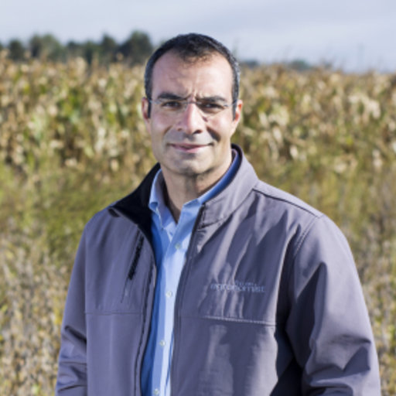
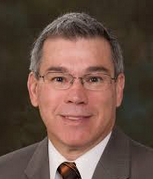
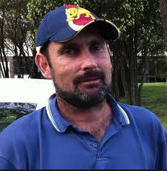

Mike Castellano
Associate Professor
Agronomy Dept.
Iowa State University
Jerry Hatfield
Fomer Laboratory Director
National Lab for Ag & the Env
USDA (retired!)
Neil Huth
Principal Research Scientist
CSIRO, Australia
Jarad Niemi
Associate Professor
Statistics Depart.
Iowa State University

Slide 83
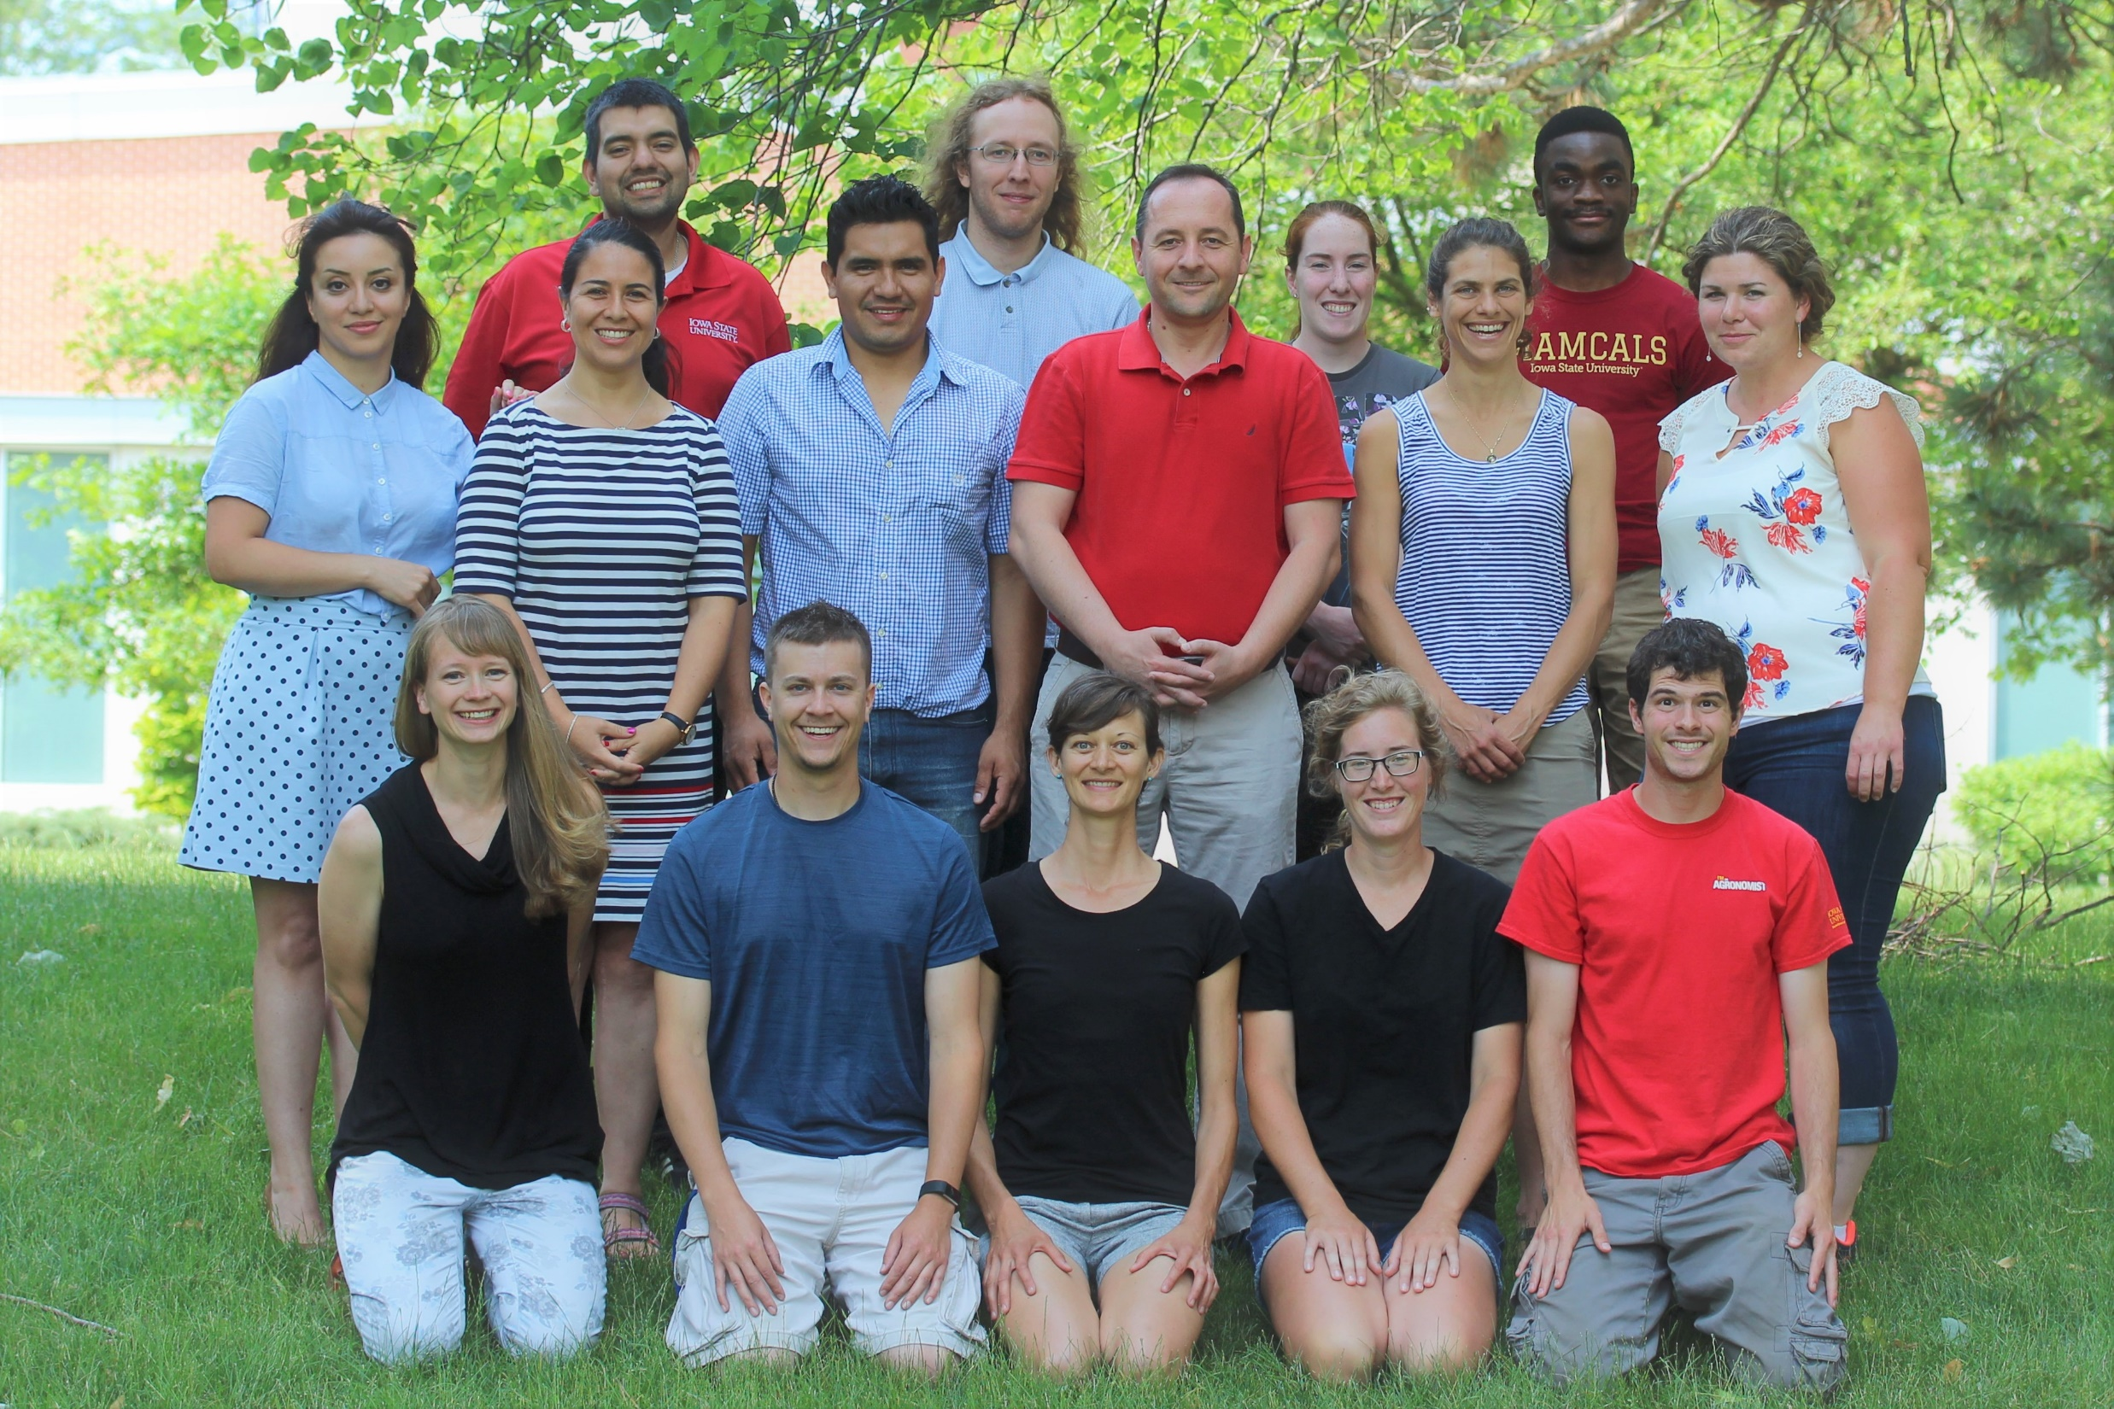

Slide 84
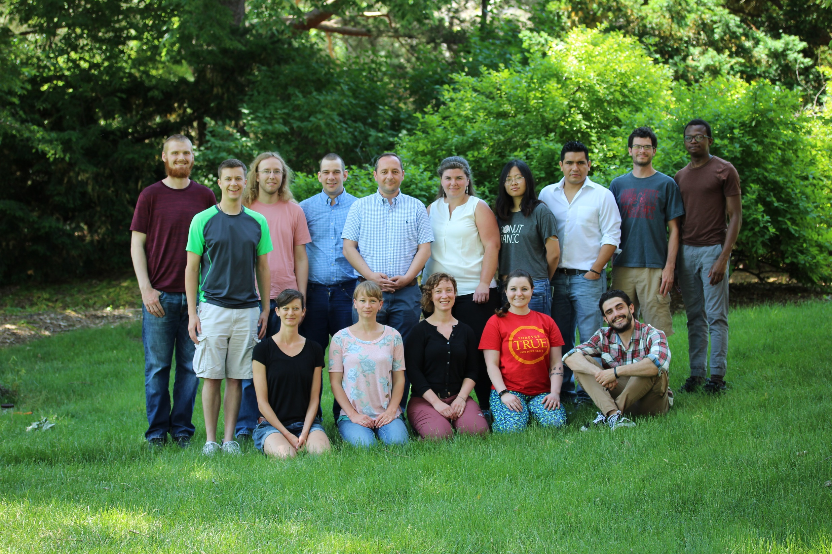

Slide 85
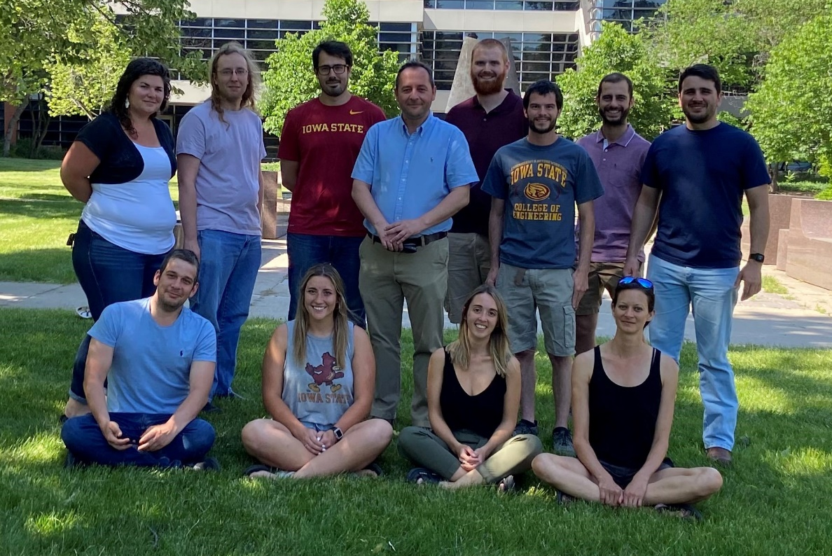

Slide 86
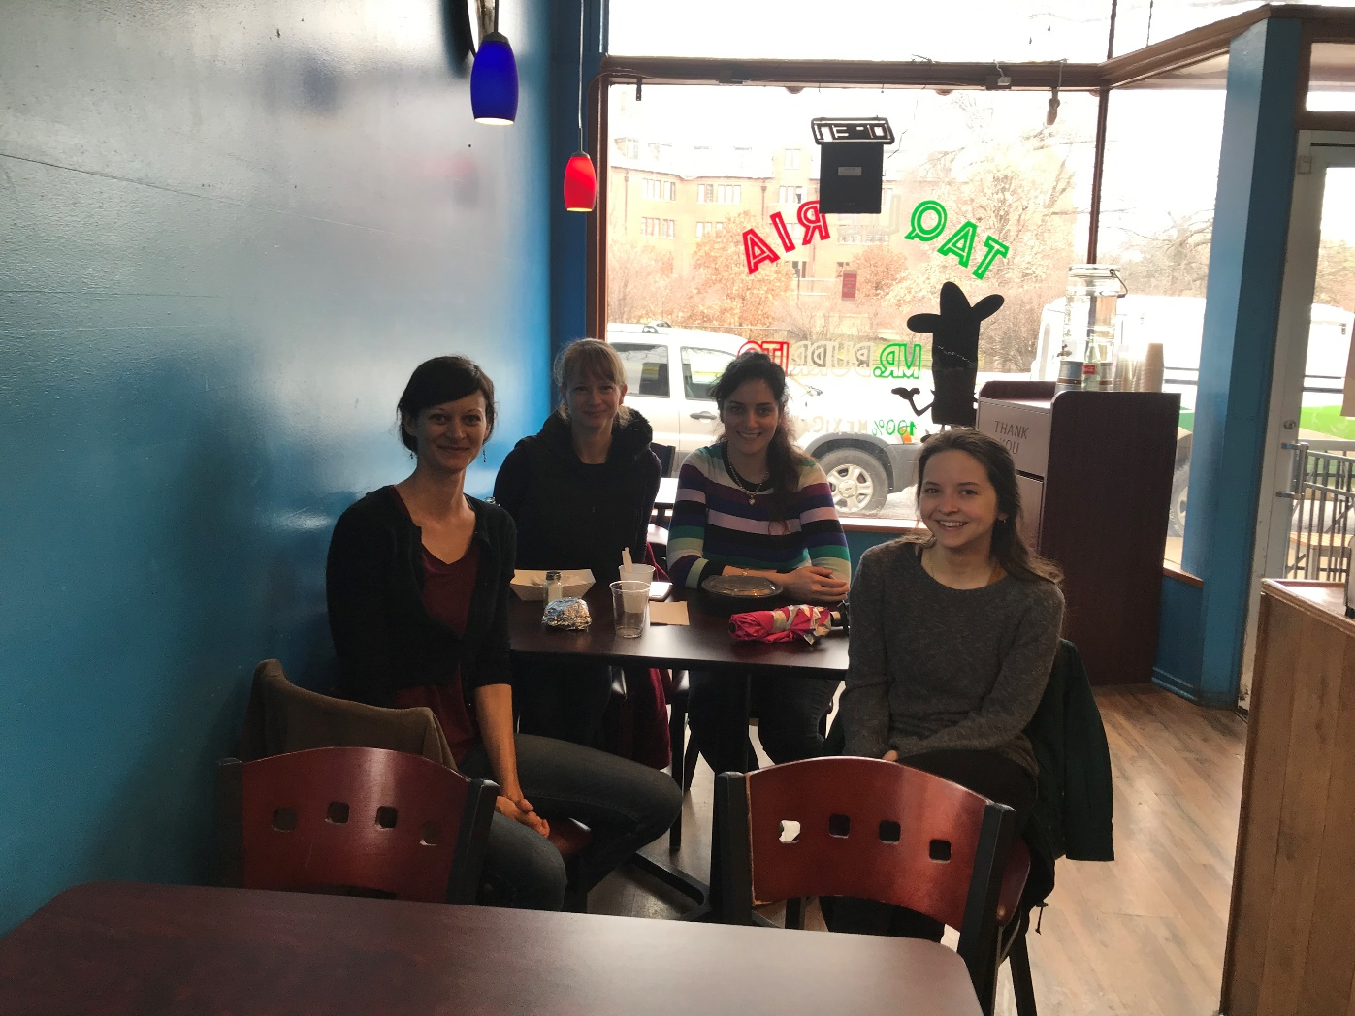
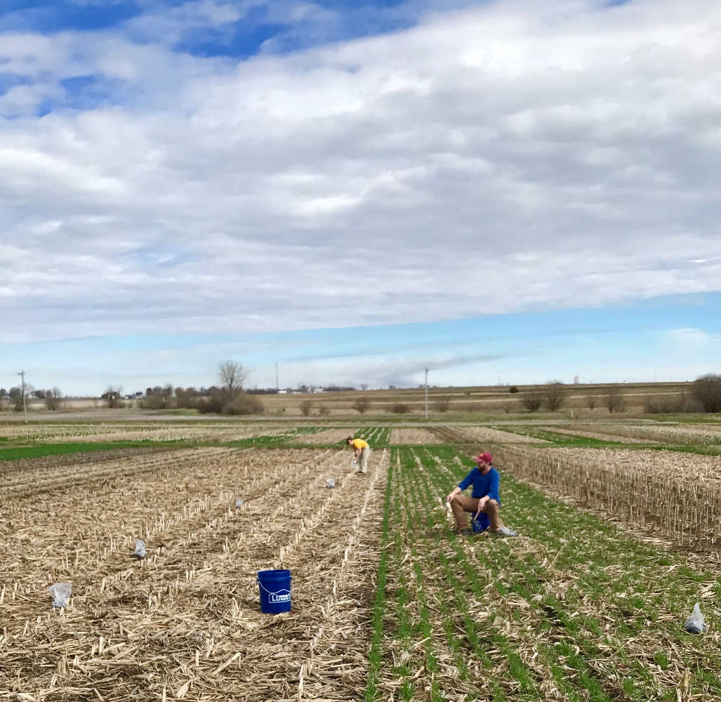


Slide 87



DataFEWSion Traineeship
Henry A. Wallace Chair for Sustainable Agriculture

Slide 88
Extras

Slide 89


Slide 91


Slide 92


Slide 93

8 sites, 151 site-years, modeled nitrate leaching at 150 and 200 kg N application

Slide 94

Example of undetermined penalty

Slide 95


